Slide 1
How to Manage Your Project with Help from Technology & AI
A Case Study

Slide 2
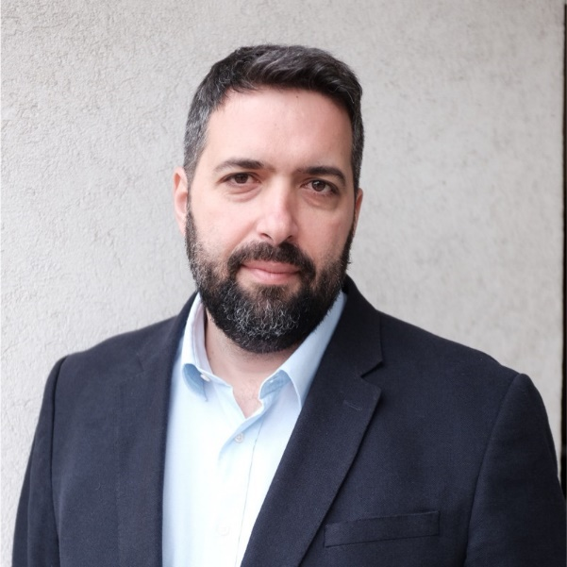
Vladimir
Milovanovic
CEO Lupa Technology
HOW IS TECH MEANT TO IMPACT YOUR BUSINESS?
Revolutionize the way you interact with project data, to collaboratively:
Optimize decision-making
Reduce risks
Bring clarity to the complexity of your projects
What have Data Management and AI got to do with winning construction claims?
As you will see from this real-life case study, everything!

Slide 3
Contractor
Employer
Head of Contracts & Risk Management for an International Contractor
100 M dispute
Employer’s SoC based on:
PM Weekly reports
P6 Schedules
NCRs
Letters / Notices to Correct
John’s company was accused of:
Project Delays
Poor Quality of Works
Damages to Facade Glass from Welding and Metal Grinding
Highly subjective documents.
Typically used as the source of truth in construction claims

Slide 4
“Our case is not looking good!”
Legal
Construction Lawyer
Experts
Delay Expert
Project Team
Project Director
Consultants
Graphics & Presentation
Paralegals
Associates
Technical Expert
P6 Planner
3 Site Managers
Commercial Manager
Coordinator
To win, we need to search the documents to:
Establish Cause
Confirm Critical Path activities independent from P6 schedules,
Find information from emails and meeting minutes that disprove what is written in the PM reports and P6 schedules

Slide 5
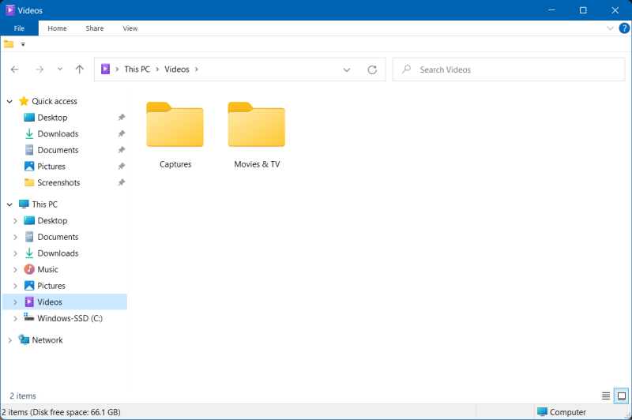
“Our case is not looking good!”
To win, we need to search the documents to:
Establish Cause
Confirm Critical Path activities independent from P6 schedules,
Find information from emails and meeting minutes that disprove what is written in the PM reports and P6 schedules
75,000 folders
700,000 files
emails
OneDrive
25 mailboxes x 40GB
1TB of data

Slide 6
Positioning Yourself for Success in a Future Claim
DATA MINING
AI
CONSTRUCTION AI
UNPACKING DATA
EXTRACTING TEXT & IMAGES
EXTRACTING DRAWING VEVCTORS
EXTRACTING P6/MPP DATA
LOGGING ALL INFORMATION
OCR
DOCUMENT CLUSTERING
TEXT PARSING
LLM SUMMARIZATION
SENTIMENT ANALYSIS
IMAGE OBJECT DETECTION
CLASSIFICATION OF DOCUMENTS
UNDERLYING ISSUES TAGS
TRADES IDS
DRAWING REVISION OVERLAYS & AI NARRATIVES ON CHANGES
P6 SCHEDULE ANALYTICS
DATA SILO LINKS
ANALYTICS…

Slide 7
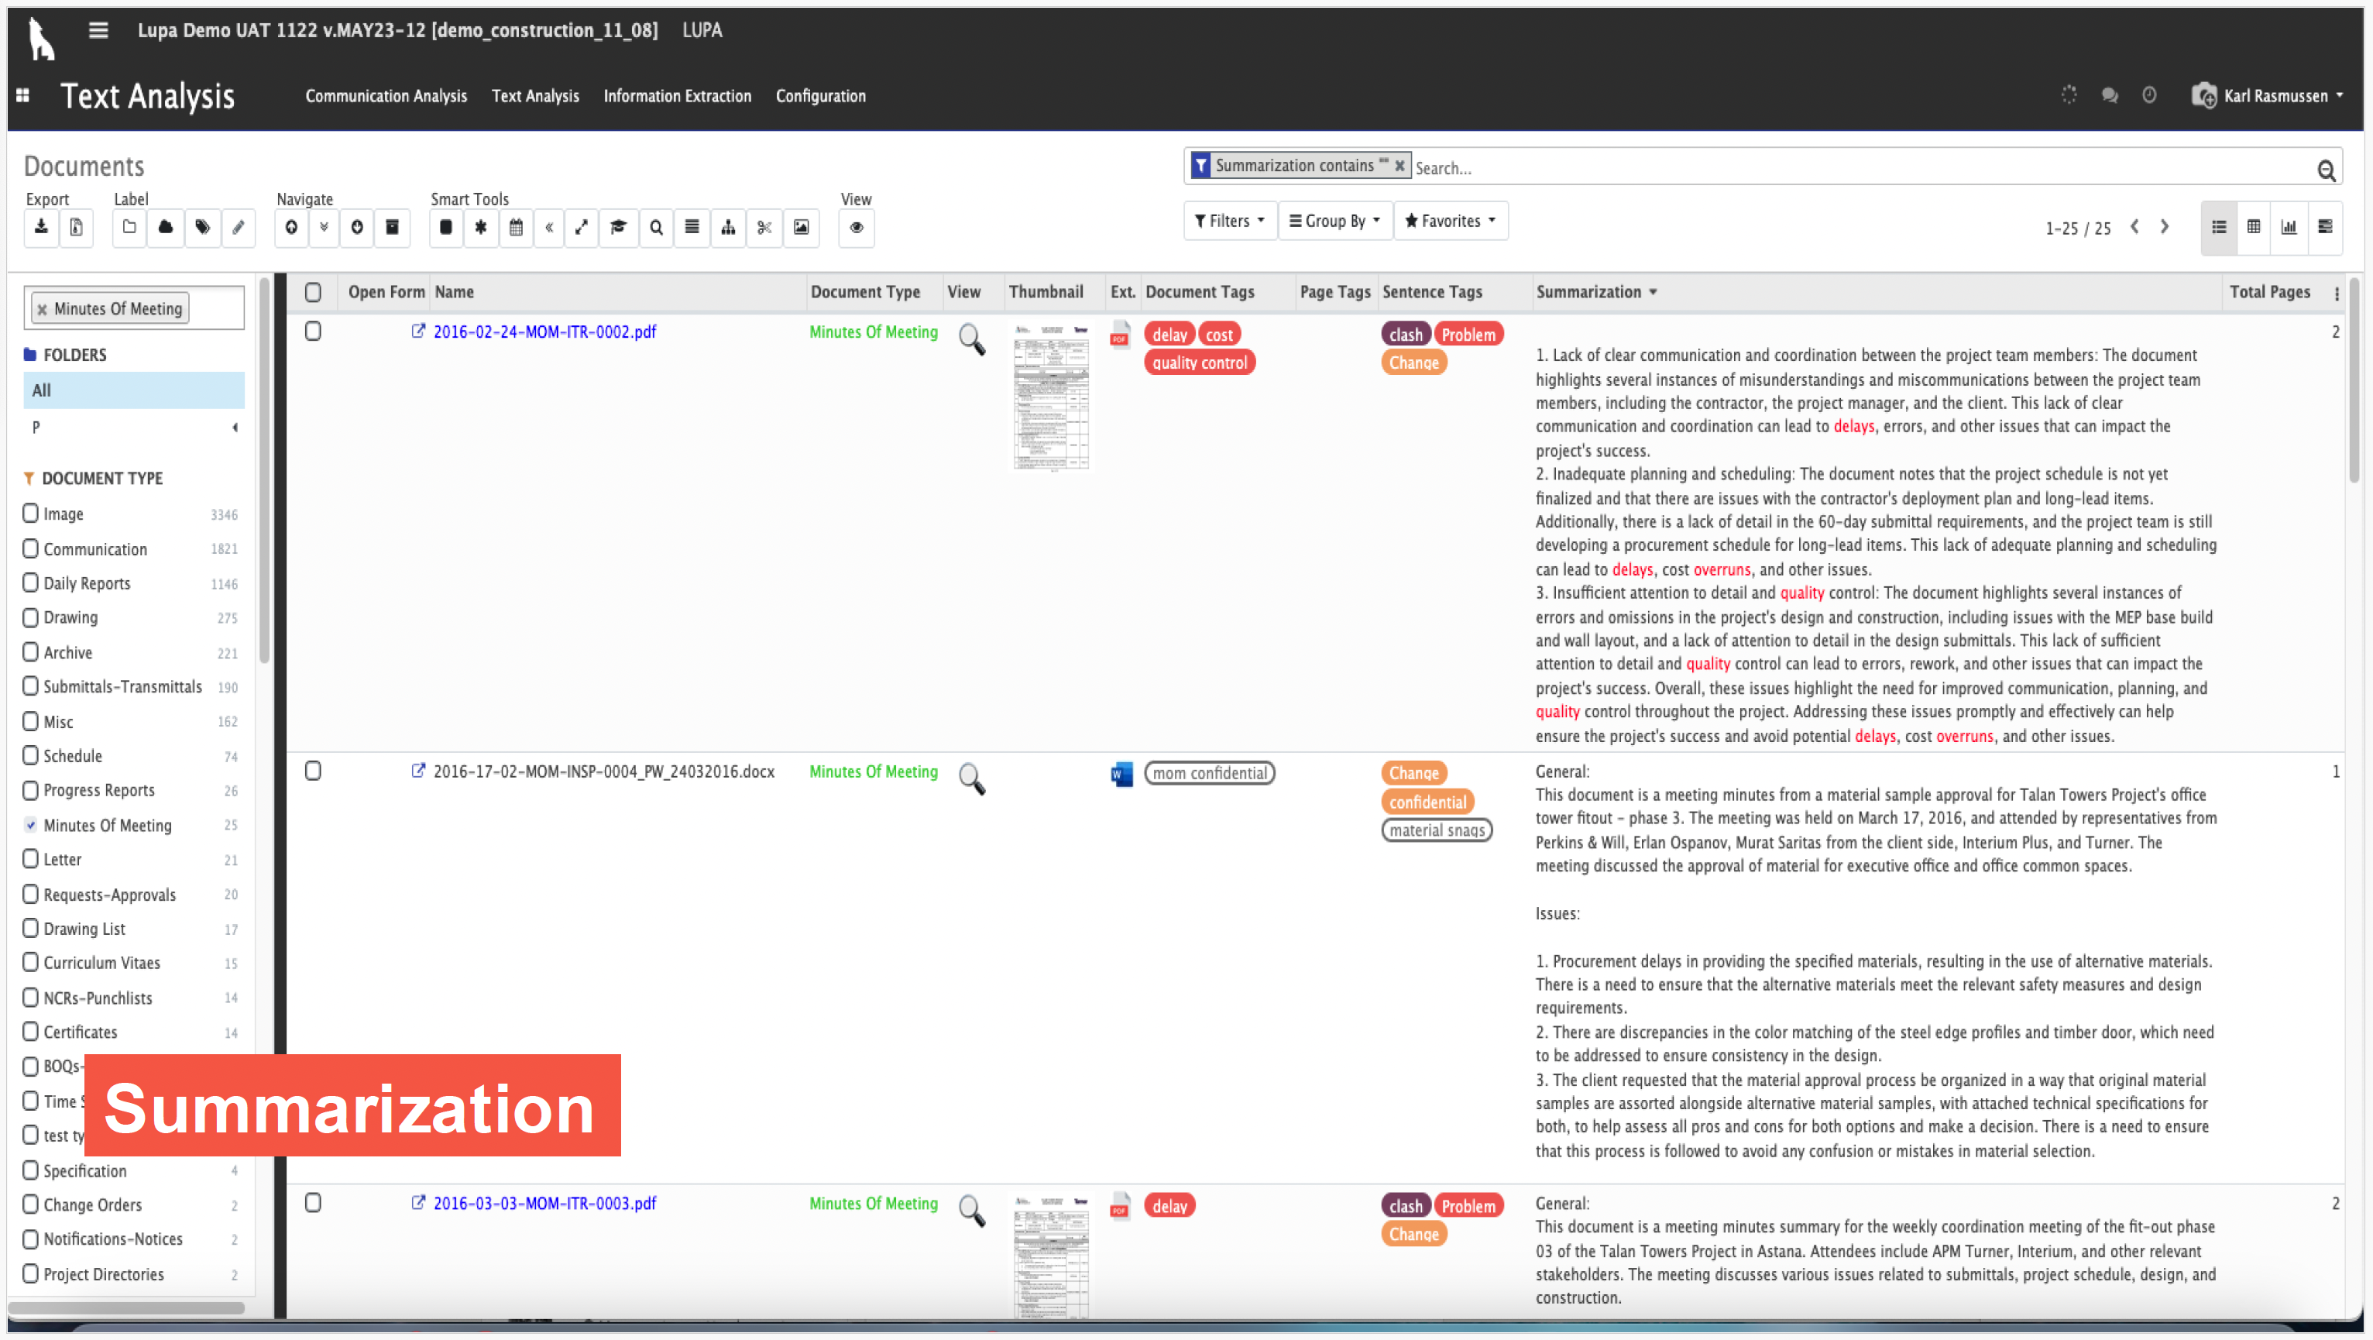
Hyper-connected & Summarized

Slide 8
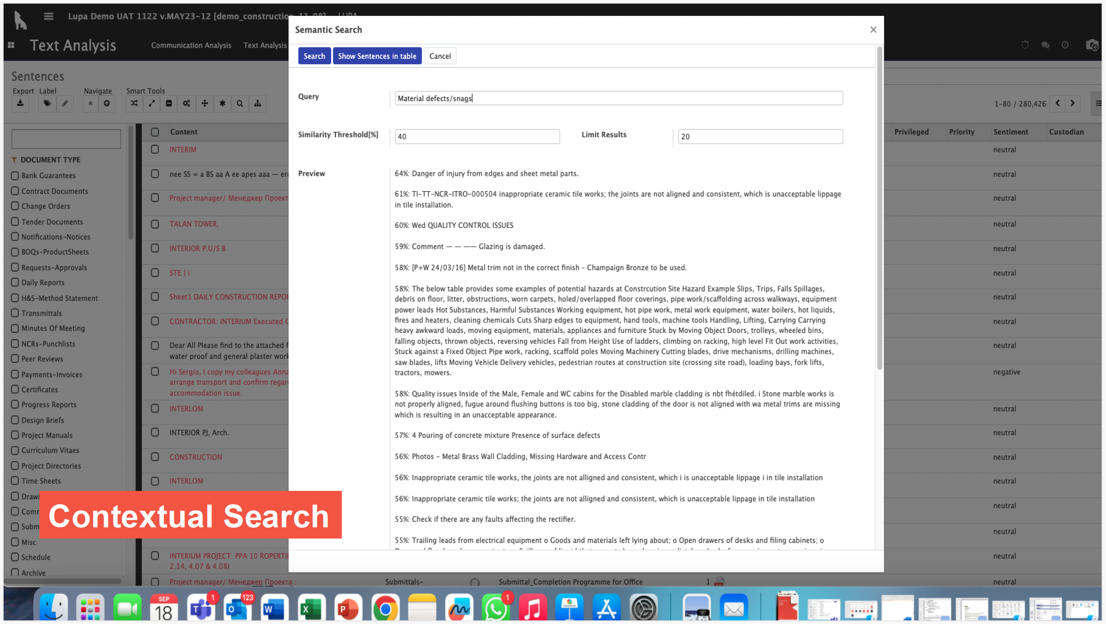
Automatic Semantic Search

Slide 9
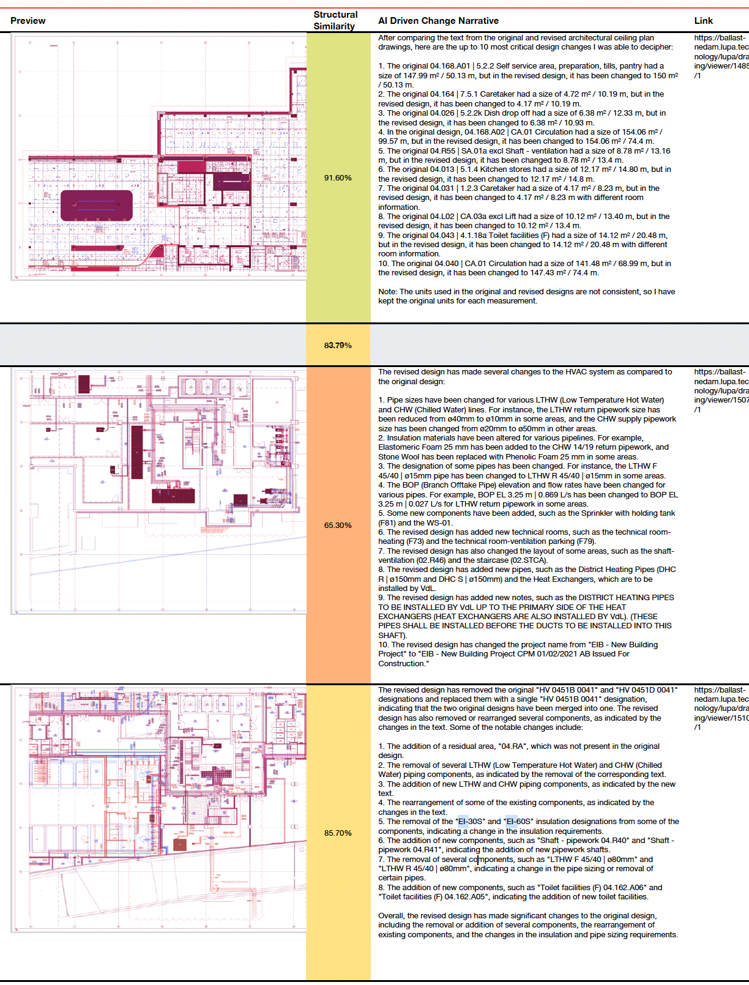
Addition of New Components (Sprinkler with Holding Tank, WS-01)
Description:
Introduction of new equipment into the design.
Example: Sprinkler with holding tank (F81) and WS-01 added.
Why It's Critical:
Space Planning: New components may require additional space not previously allocated.
Integration Challenges: Incorporating new systems can affect existing mechanical, electrical, and plumbing (MEP) layouts.
Regulatory Compliance: May introduce new compliance requirements, especially for fire protection systems.
Recommendations:
Assess Spatial Requirements: Verify that there is adequate space, including maintenance access.
Update Coordination Drawings: Reflect new components in all relevant plans.
Review Compliance Standards: Ensure new systems meet all regulatory and code requirements.
Adjust Schedules: Incorporate any additional time needed for installation into the project timeline.
Design Analytics

Slide 10
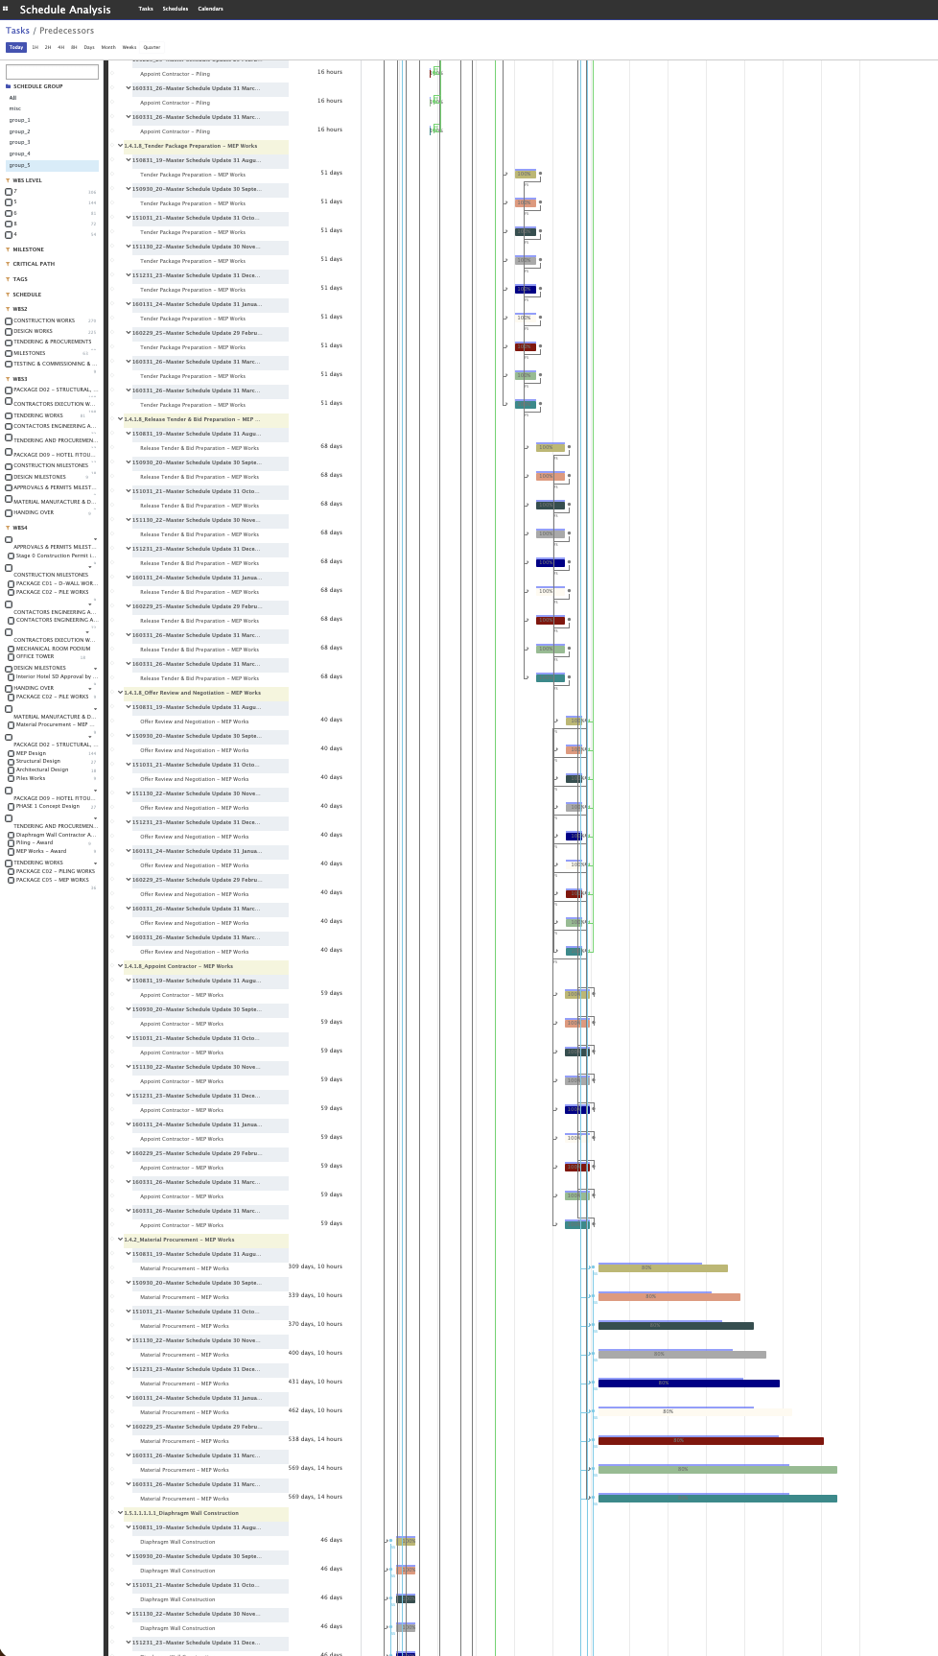
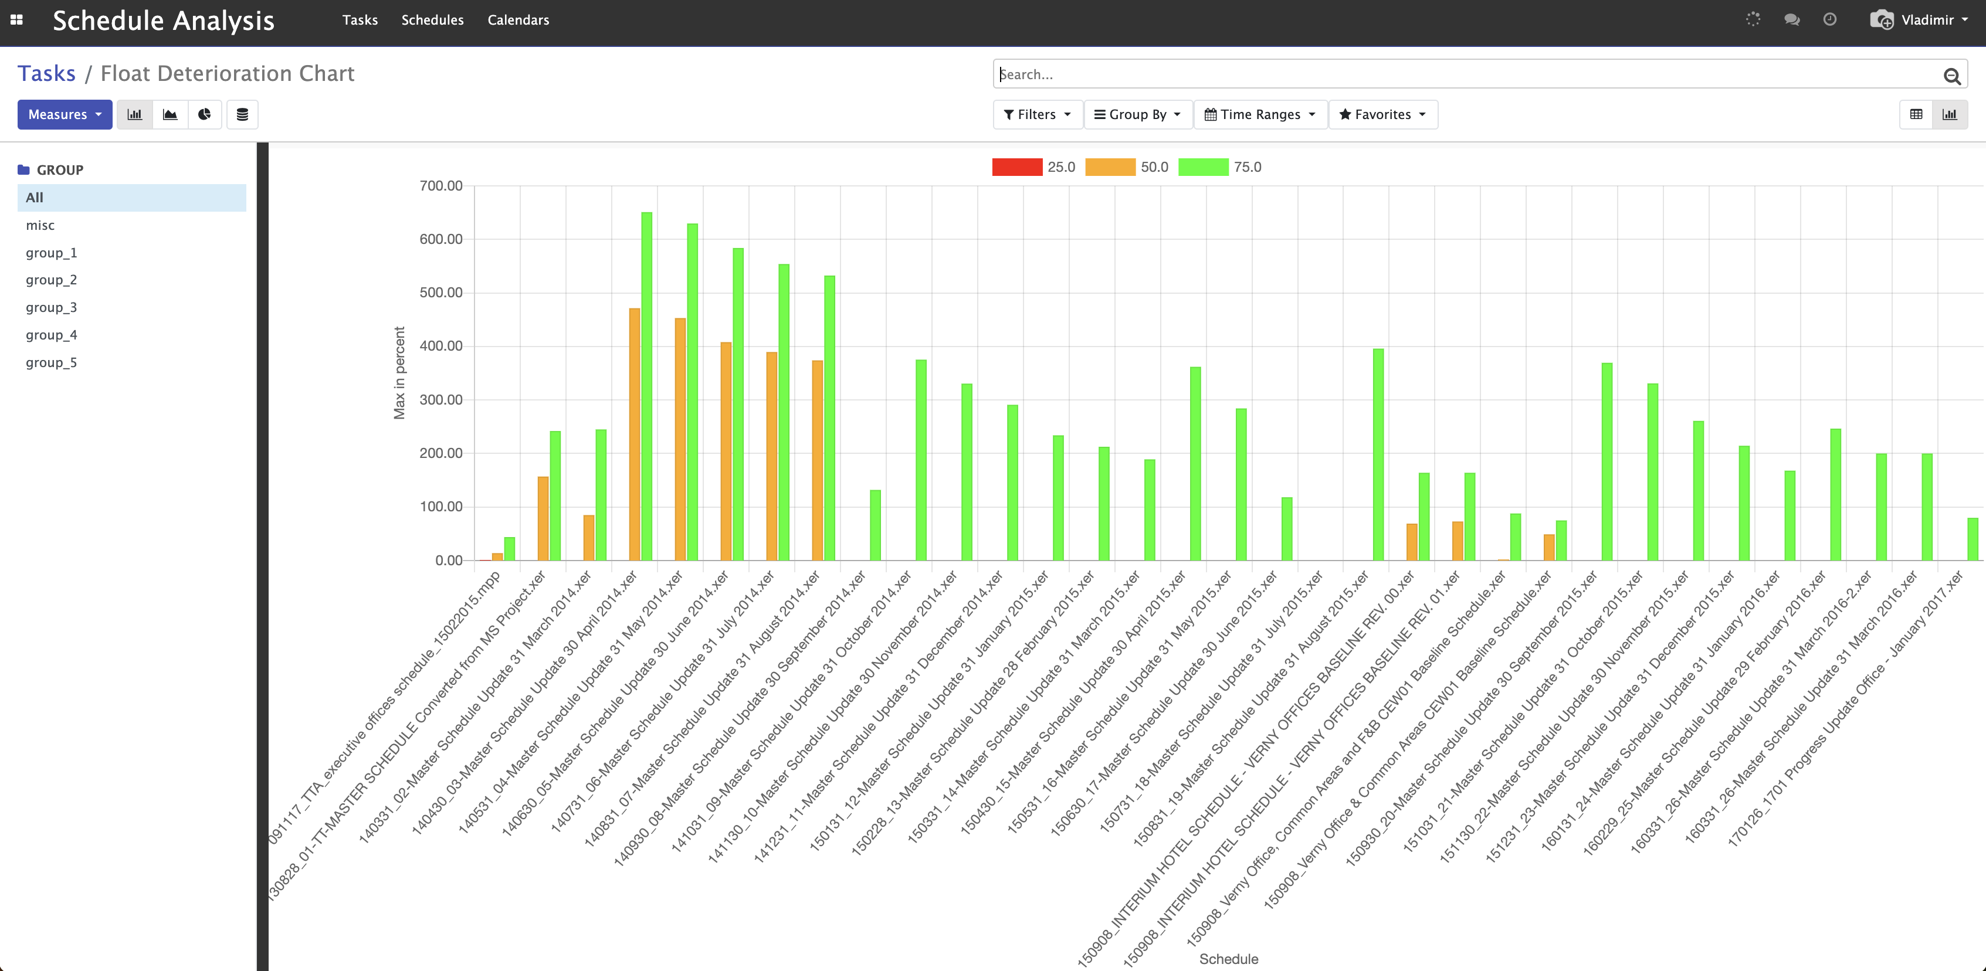
Critical Conclusions
Increased Scheduling Risk
Risk: The project has little to no buffer to absorb delays, making it more susceptible to schedule overruns.
Compression of the Project Schedule
The reduction in float suggests that tasks are scheduled tightly, possibly due to accelerated timelines or cumulative delays that have not been mitigated.
Recommendation: Re-evaluate the project schedule to determine if timelines are realistic and consider adjusting deadlines or redistributing workloads.
Implications for Project Controls
Urgent Action Required: The project is at a critical juncture where immediate steps are necessary to prevent schedule slippage.
Schedule Optimization: Explore opportunities to re-sequence tasks, overlap activities, or adjust task durations where feasible to regain float.
Contingency Planning: Develop contingency plans for high-risk areas to prepare for potential delays.
Schedule Analytics

Slide 11
Contractor
Project Delays
From communications:
critical activities on the project, which were not on the P6 schedule.
Activities which Employer’s other contractors were responsible for.
As built schedule was developed from installation procedures and communication, which showed that Employer’s other contractors were responsible for most of the delays.
From Design Analysis:
Employer kept changing MEP designs such that works could not have been completed on time.
Quality
From Documents & Photos:
Records showed that project team corrected NCRs during the last 6 months of the projects, having resolved over 90% of the NCRs.
Showed Employer’s project manager failed to formally close the NCRs, because many of them were a matter of interfacing with Employer’s other contractors, who failed to complete their works, so Contractor was held wrongfully responsible for it.
From Delivery records:
Employer’s free issue materials were defective, with substandard packaging and protection. Most remaining NCRs were a result of this.
Damages
From DCRs:
Contractors workers did weld and grind metal in the areas where the façade was damaged, but…
From Invoices:
Contractor found weekly invoices from his scaffold subcontractor, which itemized other contractors using the scaffold. It was shown that Employer’s other subcontractors also performed welding and metal grinding in the same areas during the same time. This was apportioned 50/50.
Head of Contracts & Risk Management for an International Contractor
100 M
John’s company was accused of:
Project Delays
Poor Quality of Works
Damages to Facade Glass from Welding and Metal Grinding

Slide 12
How did this play out?
Contractor
Employer
SoC was based on un-subjective substantiation
Built a strong compelling story with detailed supporting documents and straightforward analytics.
Expert team was cohesive throughout the process and got stronger at each stage of the dispute process.
Believed by the panel of Arbitrators.
Awarded 90% of the claim.
John’s Contracts & Risk group was seen as a major contributor to the company’s profitability.
SoC was based on subjective documents:
Built a story that contained broad statement, poorly substantiated, often easily proven to be wrong.
Expert team introduced a separate expert mid-way through the process, with the team clearly divided.
Mostly not believed by the panel of Arbitrators.
Awarded 10% of the Claim.
Left dazed and confused, as to what just happened…

Slide 13
Conclusion
Construction suffers from information overload and data siloes
Leveraging (big) data is crucial in both Construction Claims and Project Controls
Your project data is as an asset, same as your people and processes
Tech provides competitive advantage, and if you don’t use it, the opposing side will.

Slide 14
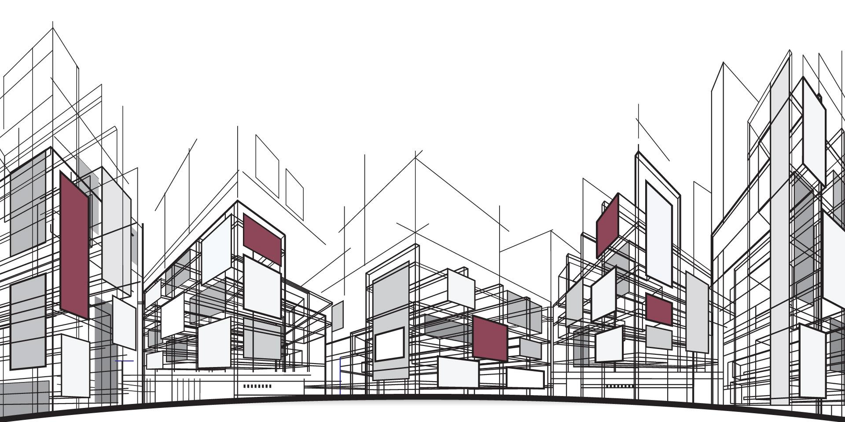
Thank You!

