Slide 1
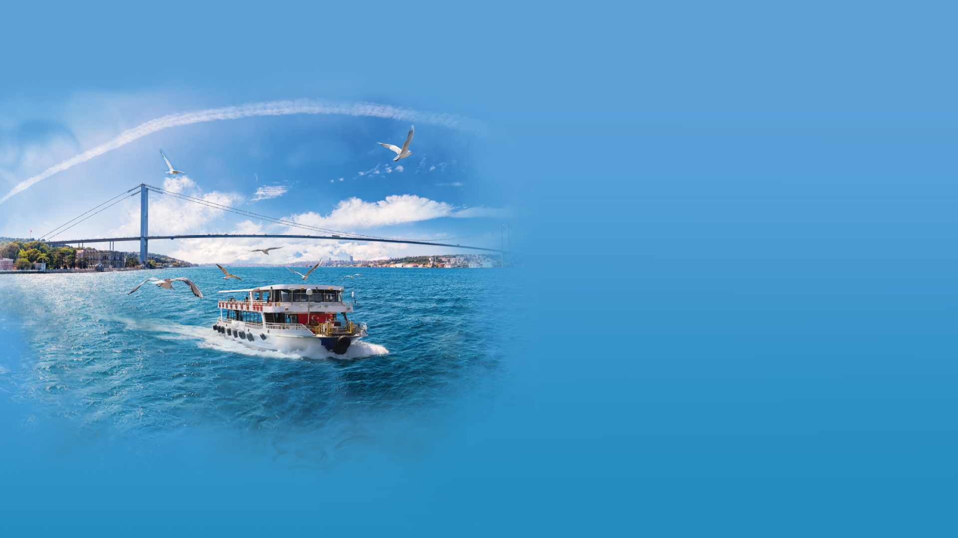
Evolving Dynamics in Energy Investments

Slide 2

Climate Crisis and Sustainability

Slide 3
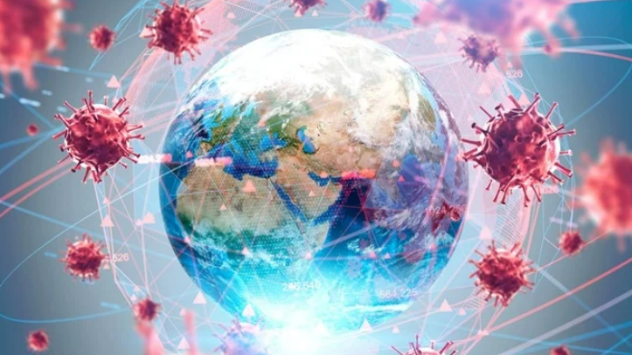
Pandemics
and
Resilience

Slide 4
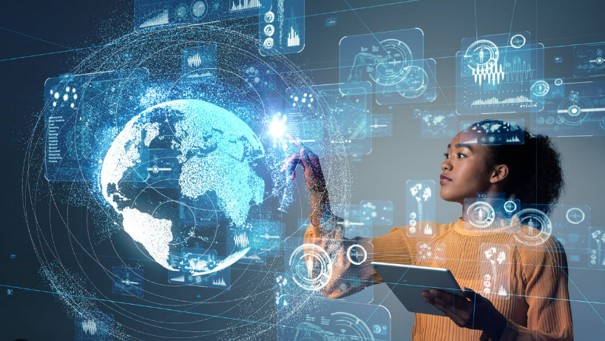
Embracing Change Through Digitalization

Slide 5
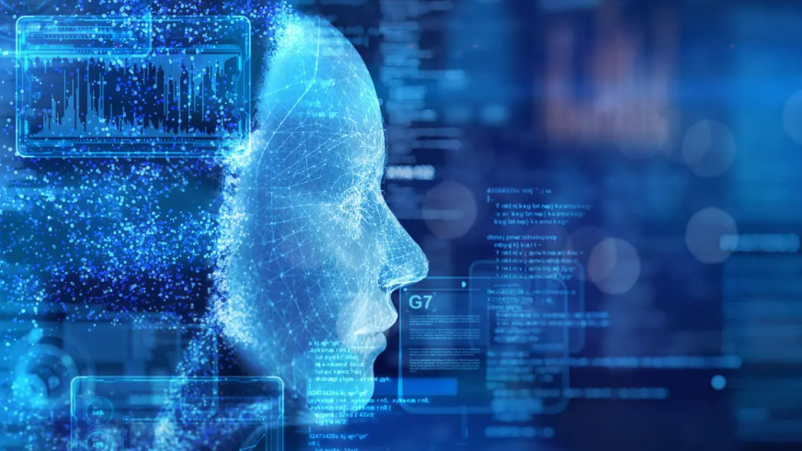
Artificial Intelligence

Slide 6
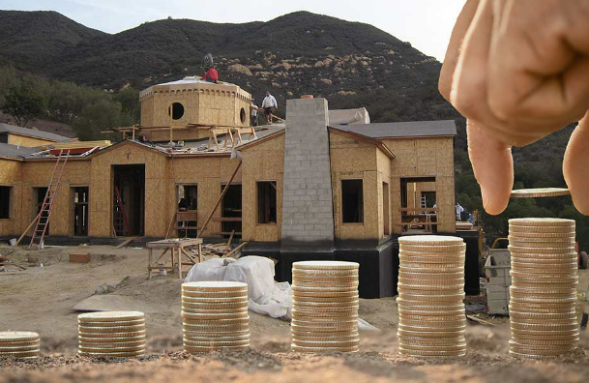
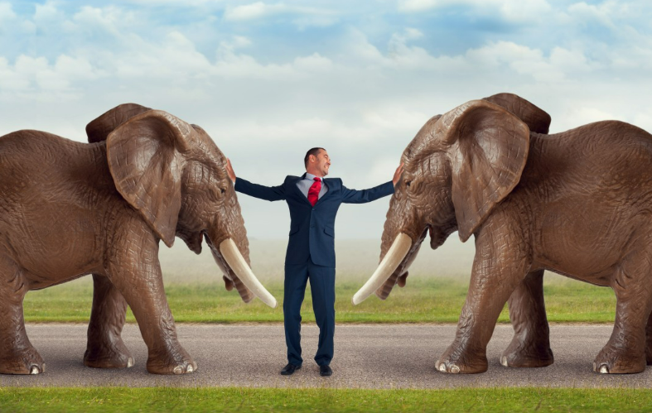

Funding
Construction
Projects
Overcoming
Disputes
&

Slide 7
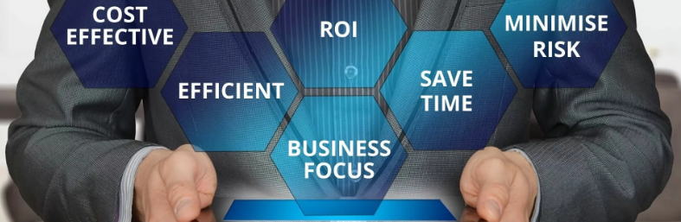
Navigating the Triad:
Cost, Time and Commercial Management

Slide 8

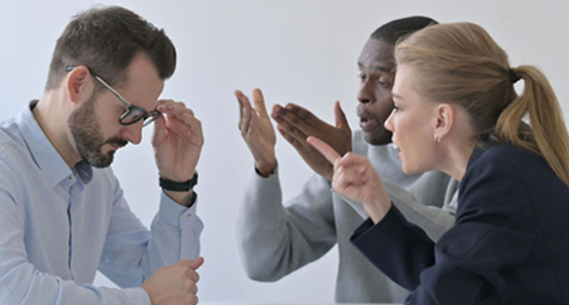
Conflicts and Challanges

Slide 9
Thank You
B.Haluk Kiziloglu
haluk.kiziloglu@tupras.com.tr

