Slide 1

A Practical Approach to APAB
Better Ways than TIA to
Visualise Progress and Delay
Andrew Woodward
Quantum Global Solutions

Slide 2

What Delay Analysis Methodology?
The Construction Industry?
99% of the time
Time Impact Analysis
(TIA)
‘loosely specified’ in CA
Tribunals
99% of the time
As-Planned v As-Built
Analysis (APAB)
Want to know what happened

Slide 3
Construction – Why Industry Chooses TIA?
SCL Protocol 1st Edition recommendation – ‘lofty ambition’
Complex and expensive to implement:
  50,000 activities – Contractor put to task
Liability first then delay – fits with ‘Notice and Time Bar’ procedures
Over time, analysis results deviate from reality:
  Changes in work sequence – execution not strictly following programme logic
Doesn’t deal with concurrency:
  It does, but practitioners [deliberately] misunderstand understand this
Deviations from reality allow result to be disputed – analysis is wrong
Easy to defer Determination to completion:
  Cash remains in Employer’s bank
  Contractor under threat of LDs at Final Account
To Employer’s benefit
(and who drafts the CA?)

Slide 4
Tribunals – Why Industry Chooses APAB?
Fact-based:
  Primary records, not computer models
Simple
Logical
Common Sense
Progress Reports (MPRs)
Inspection Requests
Submission/Approval Logs
Site Diaries
Photographs
SCL Protocol Core Principle 5
And through the Protocol 7 times

Slide 5
APAB – Better Visualisation of Delay
Five Key Points

Slide 6
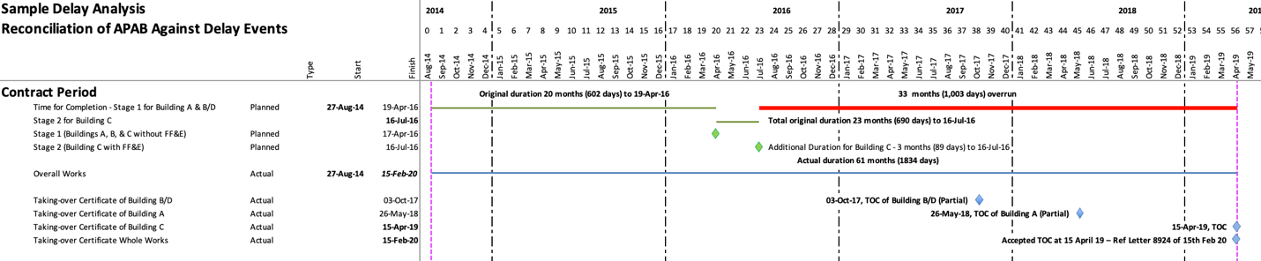
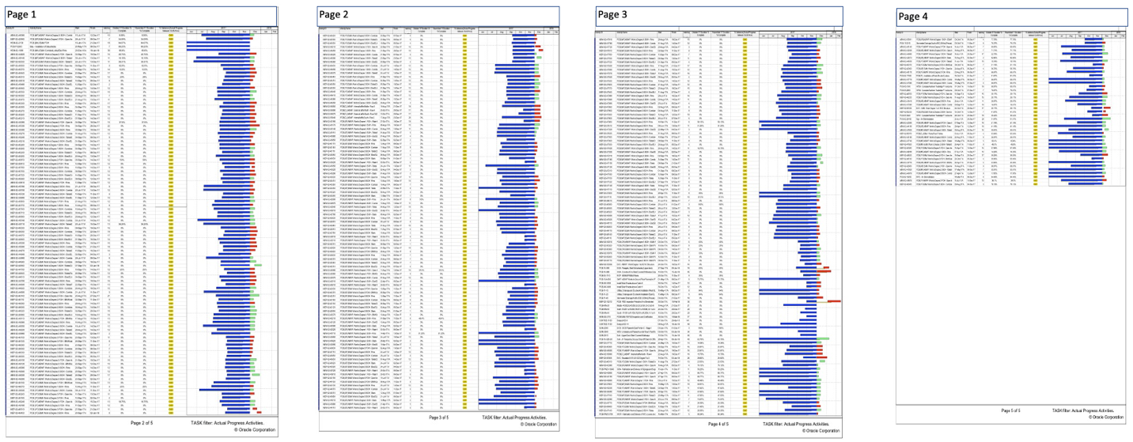
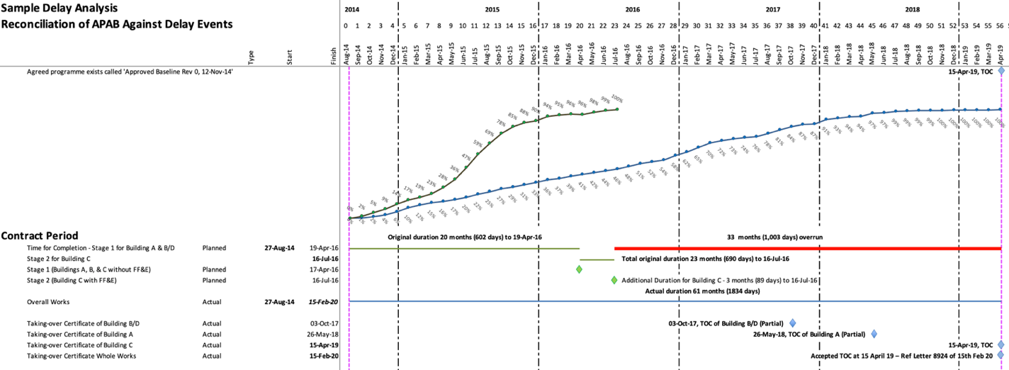
APAB – Better Visualisation of Delay
S-Curves
Banish the Infinite Blue Bar
S-Curves
Identify changes in production over time
Chart relative performance over time
looking for start/stop

Slide 7
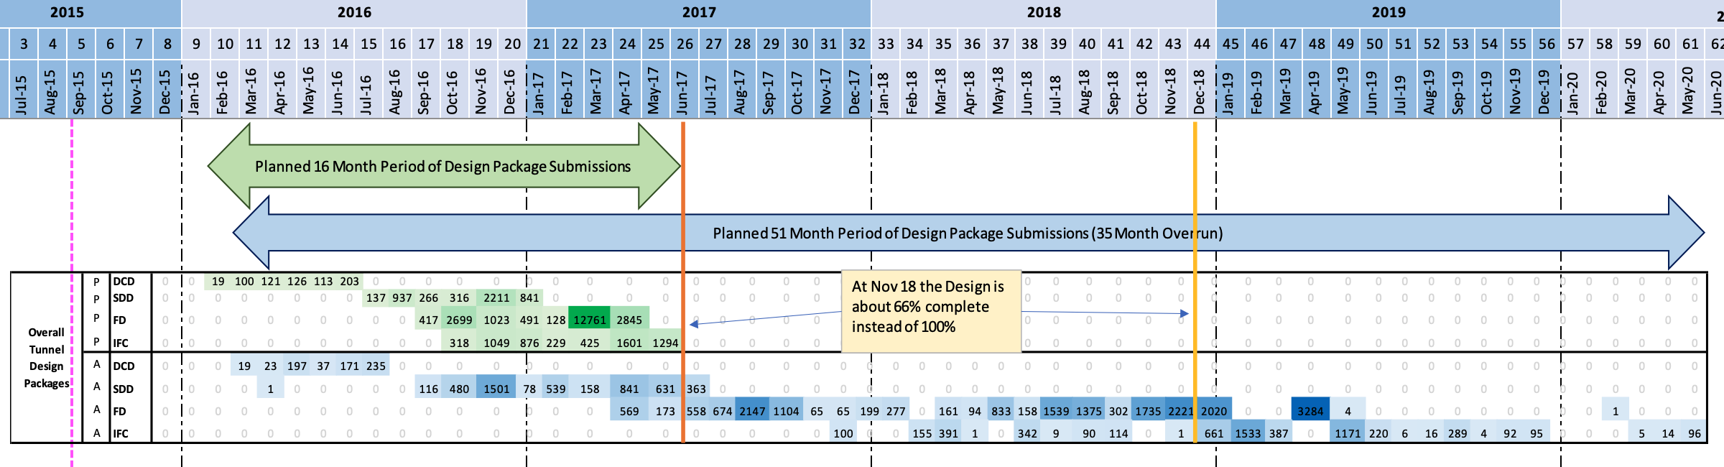
APAB – Better Visualisation of Delay
Heat Maps
Heat Maps – Assess intensity of effort over time:
Rounds of submissions
Submissions per month
Submissions and re-submissions

Slide 8
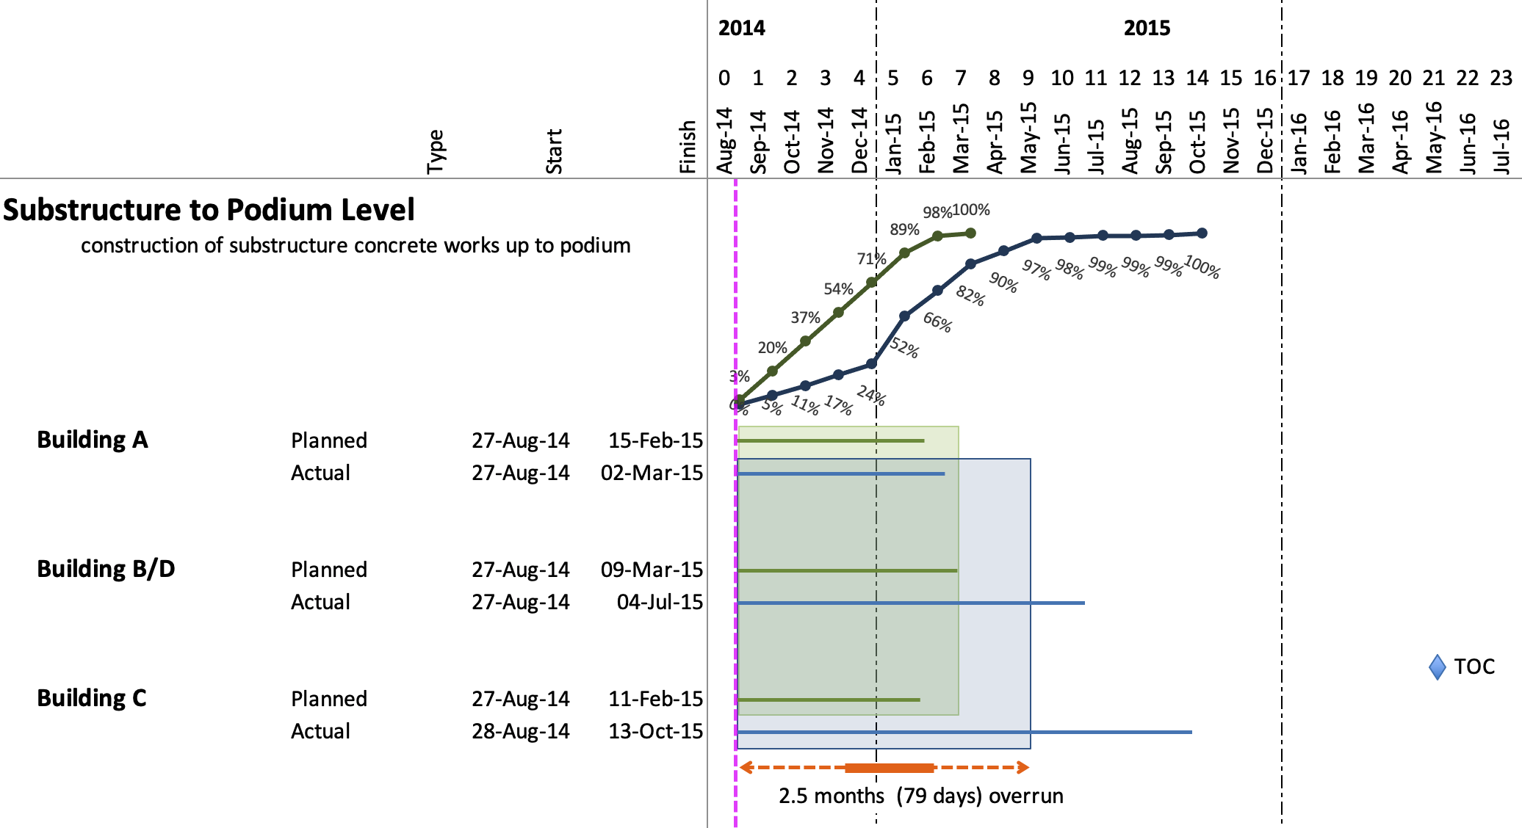
APAB – Better Visualisation of Delay
Reasonable Completion?
95%, 97%, 100%, 600%
Completion is not always 100%
Apply ‘common sense’ to Completion:
When task is complete?
When groups of tasks complete
When CP moves to other tasks
When works accepted as complete

Slide 9
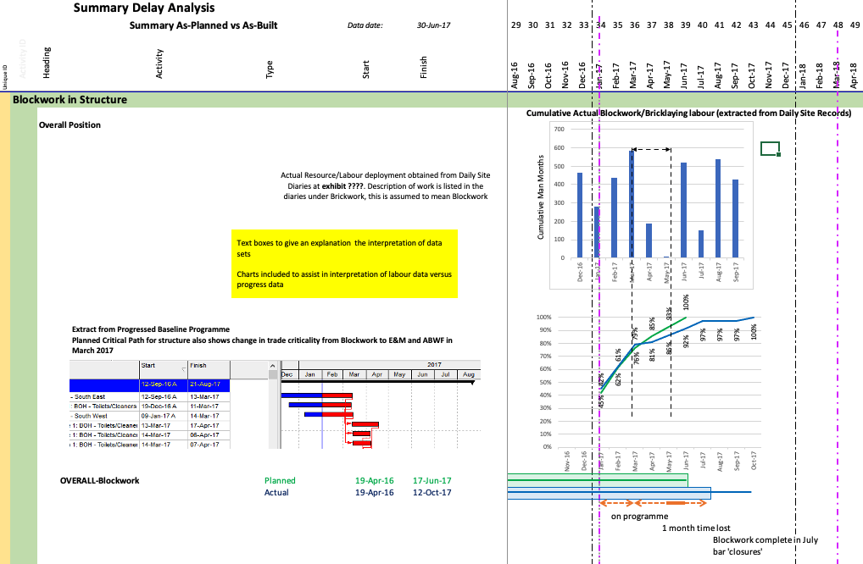
APAB – Better Visualisation of Delay
Combine Multiple Datasets
Combine datasets and look for correlation:
Relate labour to progress
Correlate lack of labour to lack of progress
Look for reasonable completion

Slide 10
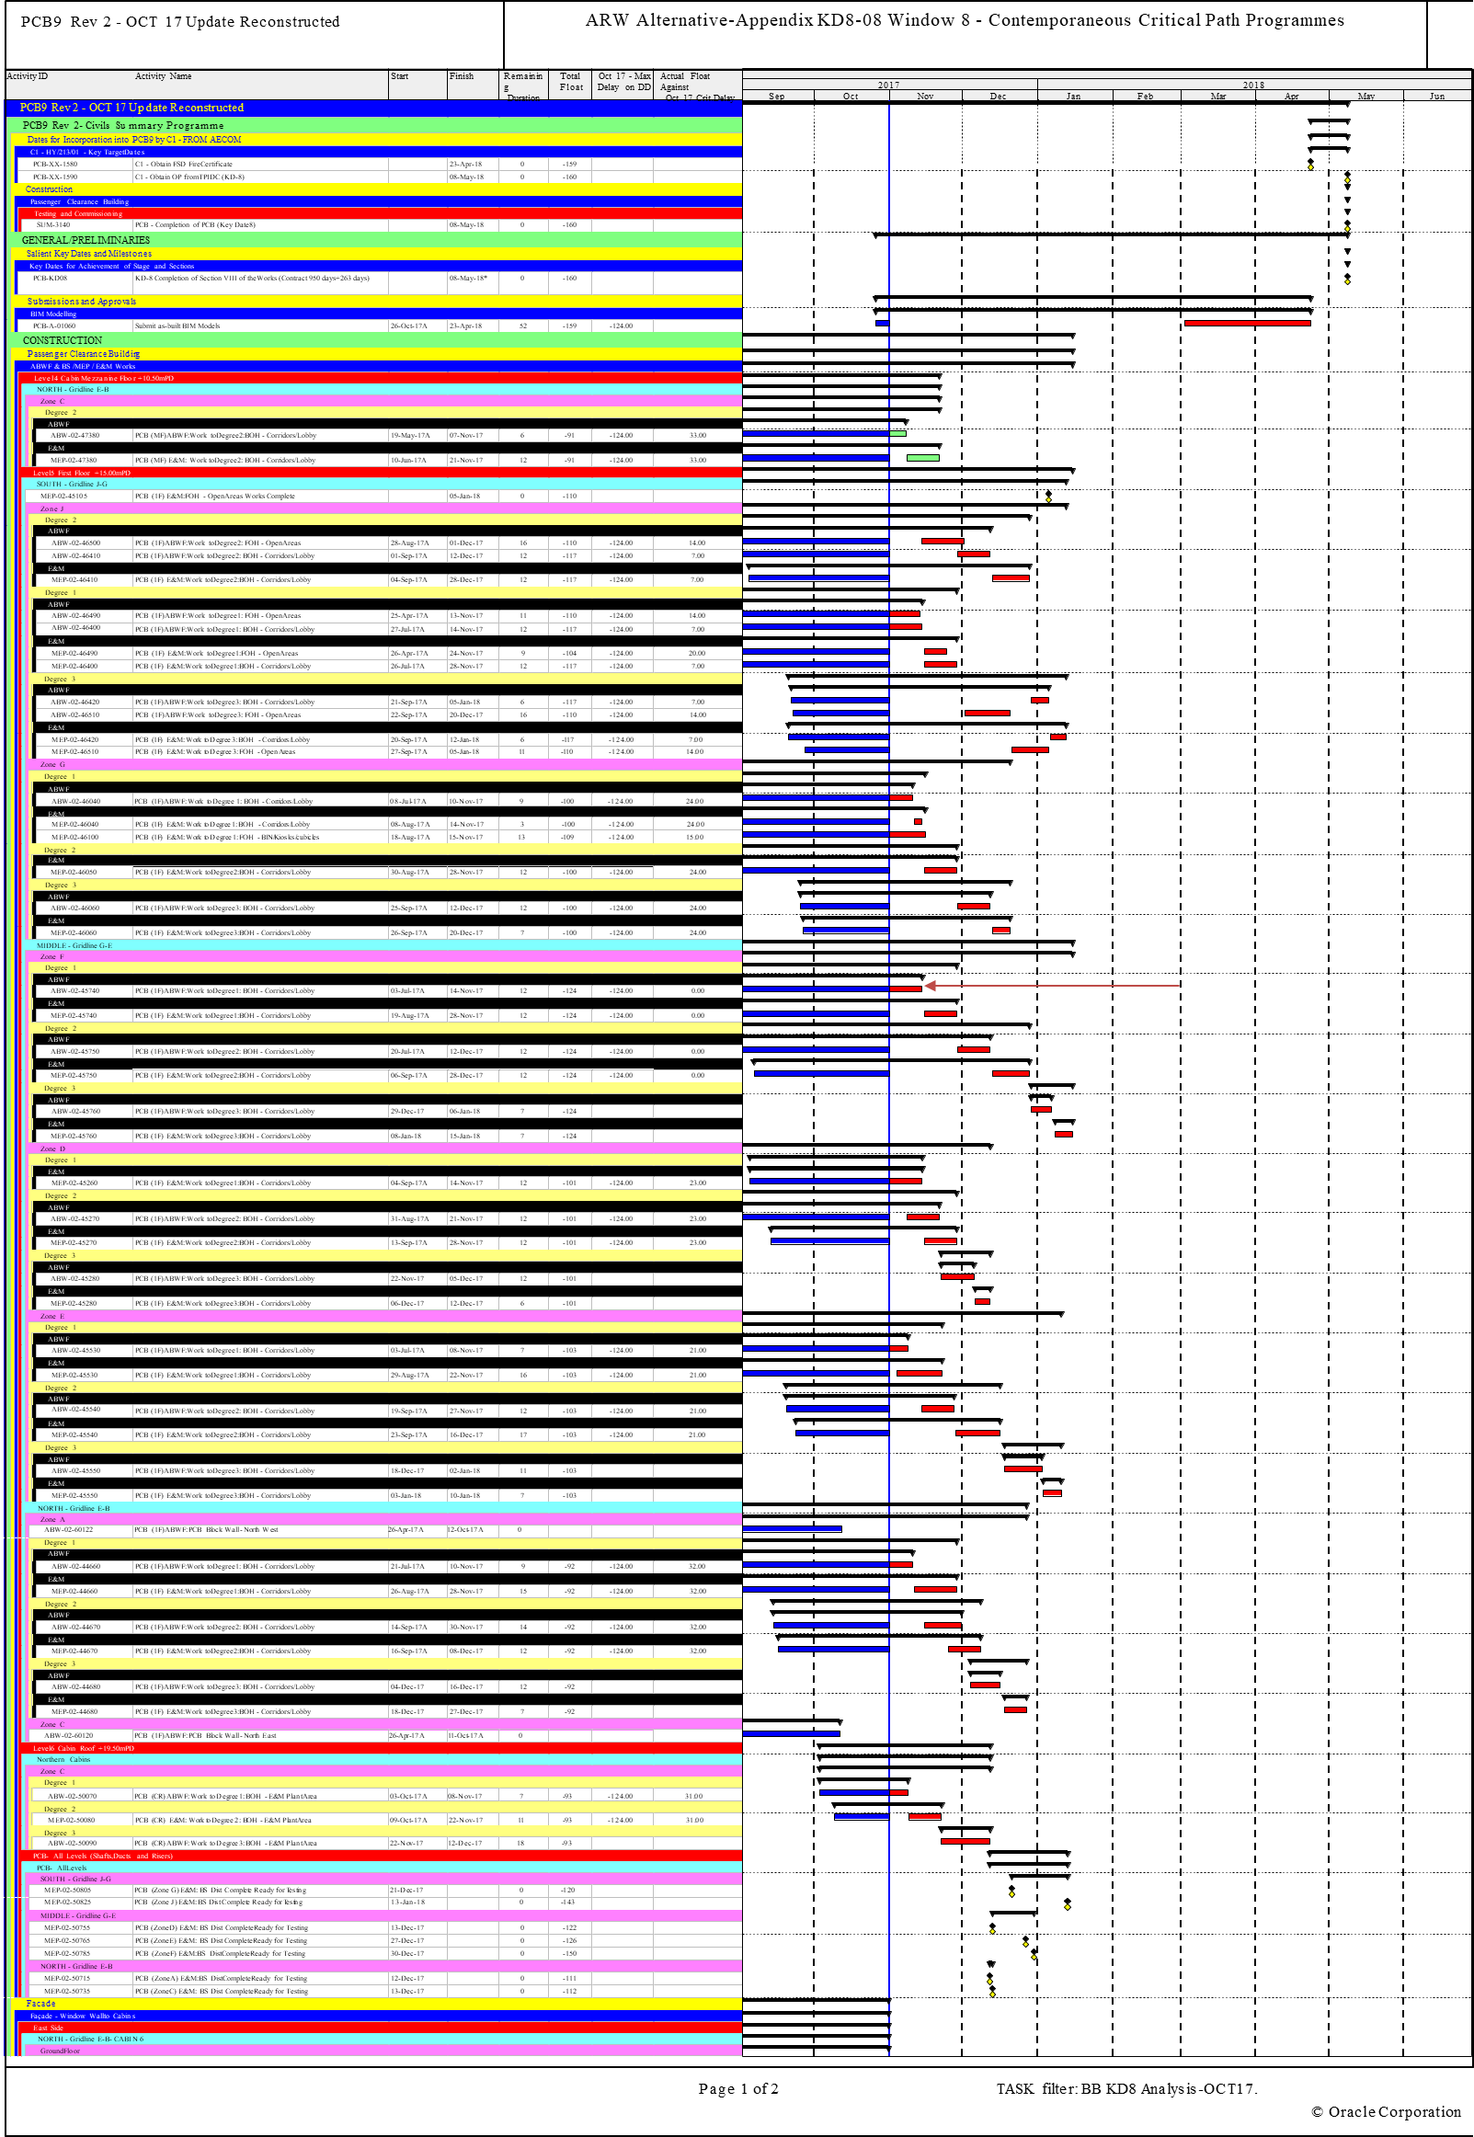
APAB – Better Visualisation of Delay
Avoid Nonsense
Avoid Illogical assessments:
Multiple activities in software cannot be on the critical path
‘must complete by’ switch misrepresenting criticality

Slide 11
Closing Thought – Tools for Delay Analysis
It’s not just planning software
It’s also:
  Charting tools – Excel, Powerpoint
  Practical analysis
  Pencil and pieces of paper
Most importantly, it’s:
Tribunals hate planning software
The application of
Common Sense

Slide 12

A Practical Approach to APAB
Better Ways than TIA to
Visualise Progress and Delay
Andrew Woodward
Quantum Global Solutions

