Slide 1

Sarwono Hardjomuljadi
President, Society of Construction Law,
INDONESIA
Board Member, FIDIC 2019-2023
Arbitrator/ DAAB

Slide 2

DAAB Practices in Indonesia and South East Asia
Sarwono Hardjomuljadi
President, Society of Construction Law,
INDONESIA
FIDIC Board Member, 2019-2023
Arbitrator/ DAAB

Slide 3

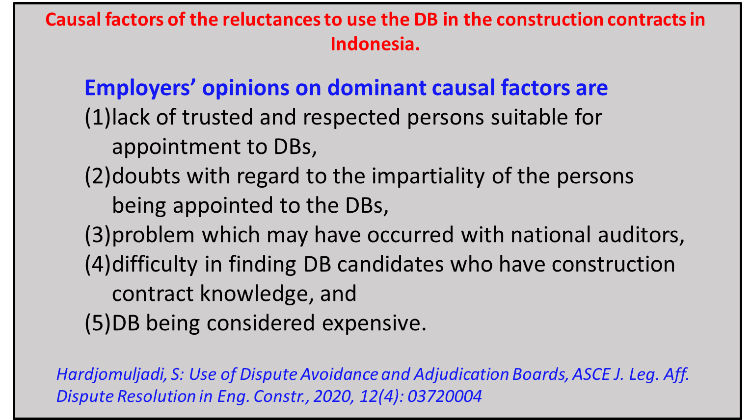

Slide 4
Causal factors of the reluctances to use the DB in the construction contract in Indonesia
Contractors’ opinions on dominant causal factors are
DBs being considered expensive,
lack of trusted and respected persons to appoint to DB,
doubts with regard to the impartiality of the persons being appointed to the DBs,
hesitation to have expenses before a dispute occurs, and
lack of dissemination about DB.
Hardjomuljadi, S : Use of Dispute Avoidance and Adjudication Boards, ASCE J. Leg. Aff. Dispute Resolution in Eng. Constr., 2020, 12(4): 03720004

Slide 5
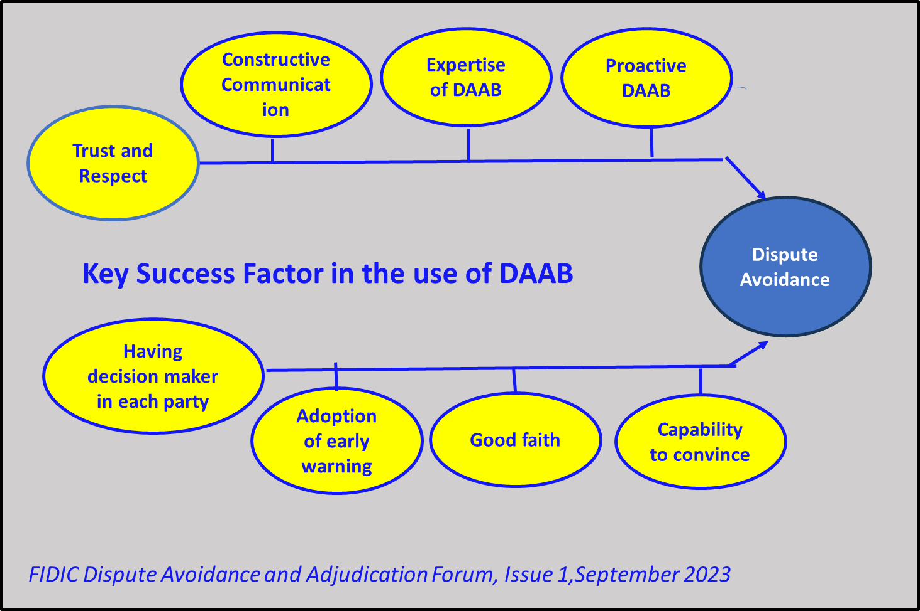

Slide 6
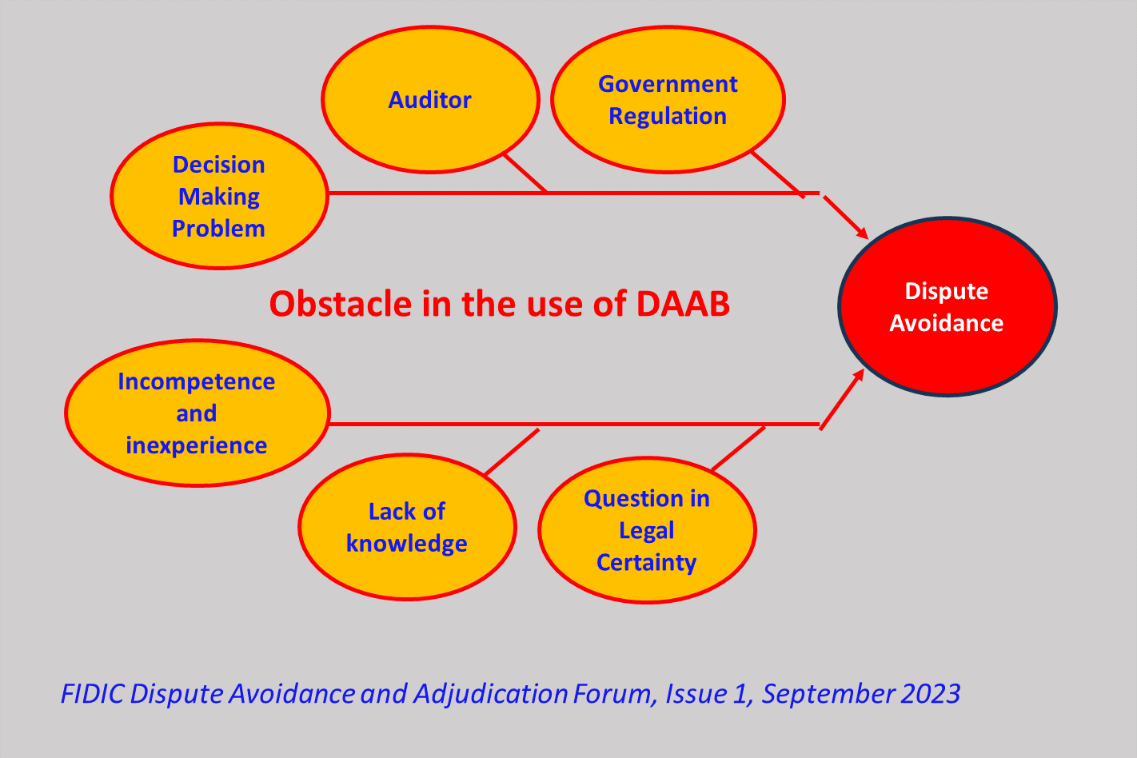

Slide 7
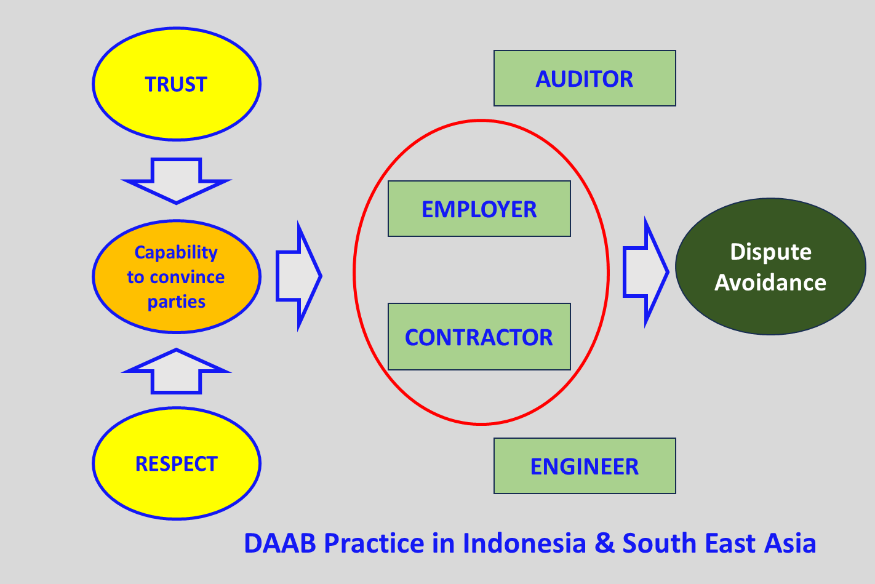

Slide 8


Thank you

