Slide 1

Pursuing claims for the effects of COVID19 and Ukraine War
Charles Blamire-Brown

Slide 2

Navigating through troubled times
2020: COVID-19 pandemic
2020/2021: Global inflation
2022: Ukraine war – global inflation 2.0!

Slide 3
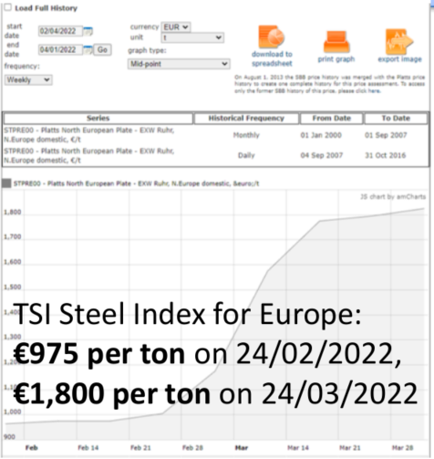
Price Escalation
Commodity price increases during the war in Ukraine
  The price of steel, for example, has seen significant increases:
*Extract from the “Official FIDIC International Contract Users’ Conference 2022” slides

Slide 4
Increase in Contractors’ claims
Commercial pragmatism often prevailed
  Step outside rigid constraints of contracts to make ‘best for project’ decisions
Inevitable lag in unresolved claims coming before dispute boards, courts, arbitration

Slide 5
Contractual bases of claim
First stop: Exceptional Event / Force Majeure
  NB – no general concept of FM under common law (compare to certain civil law jurisdictions)
  2017 SC 18.1 and 18.4 / 1999 SC 19.1 and 19.4
18.1
Exceptional Events
Exceptional Event means and event or circumstance which:
is beyond a party’s control;
the Party could not reasonably have provided against before entering into the contract;
having arisen, such Party could not reasonably have avoided or overcome; and
is not substantially attributable to the other party.
An Exception Event may comprise but is not limited to any of the following events or circumstances provided that conditions i. to iv. are satisfied:
war, hostilities (whether war be declared or not), invasion, act of foreign enemies;
rebellion, terrorism, revolution, insurrection, military or unsurped power or civil war;
riot, commotion or disorder by persons other than the contractor’s personnel and other employees of the Contractor and Subcontractors.
(…) f. natural catastrophes such as earthquake, tsunami, volcanic activity, hurricane or typhoon.

Slide 6
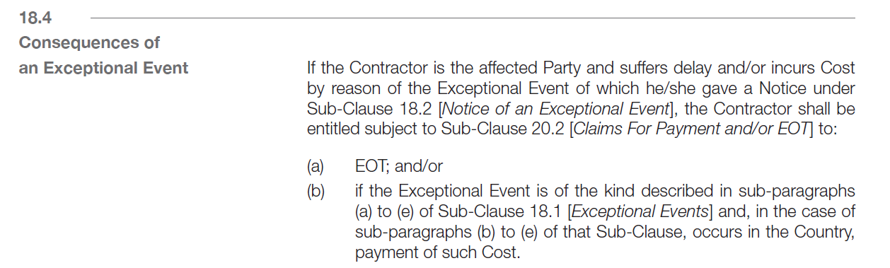
Contractual bases of claim
Effects of Exceptional Event / Force Majeure under FIDIC
Even if the pandemic is regarded as a “natural catastrophe”, that is not an Exceptional Event which gives entitlement to payment under 18.4.
EOT but no costs
War doesn’t need to occur within the Country to qualify for an entitlement to costs – but “is Party prevented from performing any of its obligations”?

Slide 7
Contractual bases of claim continued
Unforeseeable shortages in the availability of personnel or Goods caused by epidemic or governmental actions
  2017 SC 8.5(d) / 1999 SC 8.4(d)
  EOT
Change in Law
  2017 SC 13.6 / 1999 SC 13.7
  EOT and Cost
Others:
  Delays to access – SC 2.1 – EOT and Cost
  Engineer’s instruction and Variation – SC 3.5 / 13.3
  Delays caused by authorities – SC 8.6

Slide 8
Contractual bases of claim continued
Price escalation – SC 13.7 2017 / SC 13.8 1999
Indirectly recovering inflationary cost as a consequence of entitlement to recover Cost for other qualifying relief events
Loss or damage caused to the Works, Goods or Contractor’s Documents because of the war – SC 17.2(e)
  If rectification of loss or damage is instructed by the Engineer under SC 17.2 – Variation (value or Cost plus Profit + EOT)

Slide 9
Legal bases of claim at law
Force Majeure
  Not a general principle under common law
  Civil law - generally no costs but relief from performance/discharge of contract
    China – Article 180 of the PRC General Rules on the Civil Law and Article 117 of the PRC Contract Law
    UAE – Article 273 UAE Civil Code – impossibility; contract extinguished
    France – Article 1218 French Civil Code –
      “event beyond the control of the affected party that could not reasonably have been foreseen at the time of the conclusion of the contract and whose effects could not be avoided by appropriate measures.”
      Excuse non-performance – temporary unless justifies termination; Article 1231(1) – not liable for damages for non performance due to FM
Frustration
  Contract discharged when something occurs after contract’s formation which renders it impossible or illegal to fulfil or makes performance radically different from what was originally envisaged = high bar!

Slide 10
Legal bases of claim at law
Hardship
  UNIDROIT Principles – Article 6.2.3
    Occurrence of events after conclusion of contract fundamentally alter the equilibrium of contract and could not reasonably have been taken account of at the time of conclusion of the contract
    Disadvantaged party entitled to request renegotiation
    Failure to reach agreement within reasonable time – can resort to the court (which can terminate or adapt the contract)
  French law – imprévision / Article 1195 French Civil Code
Local legislation specifically passed to deal with impacts and financial support
  Singapore – COVID-19 (Temporary Measures) Act 2020 (passed on 7 April 2020) – excuse performance – no entitlement to claim LDs / enforce performance security etc
  Australia – made USD 1,500 per fortnight jobkeeper payment for 6 months for each employee that had suffered 30% (50% for large organisations) reduction in turnover
  Hong Kong – introduced Anti-Epidemic Fund – paying eligible consultants/contractors USD 6,500 each etc

Slide 11
Causation hurdle
COVID
  Site lockdowns – limited for public construction projects
  Public health requirements – difficult to establish impacts of reduced productivity (eg home working studies)
Ukraine
  Inflation spikes – multiple causes – COVID – which component unique to Ukraine?

Slide 12
Causation hurdle
Commercial negotiations – less of an issue.
Presenting claims before a tribunal – more of an issue.

Slide 13
Causation hurdle
Tribunals/courts tend to be pragmatic:
  Accept Covid / Ukraine war as qualifying event
  Causation
    Prove case on balance of probabilities
    Recognise attempts to deglobalise:
      Delay analysis – demonstrating delays to critical path
      Disruption analysis – ‘measured mile’
      Wider studies
      Witness evidence – identifying as many specific impacts as possible
Focus on detailing examples of materials/personnel restrictions impacting works on critical path

Slide 14
Other hurdles
Mitigation
  FM clause usually expressly requires parties to mitigate – eg FIDIC 2017 – SC 18.3
Notices - condition precedent?
  EG FIDIC 2017
    18.2 – Notice of an Exceptional Event – 14 days of becoming aware or should have become aware of Exceptional Event – in order to excuse performance
    18.3 – If Exceptional Event has continuing effect – affected Party give further Notices describing the effect ever 28 days.
    18.4 – Notice per Sub-Clause 20.2 to claim EOT/additional payment – NB 28 day time bar.

Slide 15
Conclusions
COVID, Ukraine and ensuing inflation – unprecedented.
Unprecedented times calls for a different approach.
Need for ‘best for project’ thinking and collaboration – to deal with issues of such impact to the industry as a whole.
Such an approach advocated by industry when Parties first had to deal with COVID
Similar approach taken by Tribunals/courts? We shall see…

