Slide 1

Charles Lilley
Partner
Construction & Engineering disputes
Bryan Cave Leighton Paisner
UAE (2009-2023)
London (until 2009)

Slide 2


Terminology
History
FIDIC and
Middle East
1987: used well past sell-by date
1999: ‘Delete clauses 20.2 - 20.5’… why?
2017: …?
Mindset gradually changing
Why?
Have the perceived problems been resolved?

Slide 3
Why deleted? Perceived
& actual problems:
  Added layer (& fees)
  Interim solutions don’t always suit
  (the Employer..)
  Challenging enough to agree arbitration clause – knowledge gap
  Enforcement
  No support from legislative framework
Why is the mindset changing?
  Cost of arbitration?
  Cashflow, half-finished jobs
  KSA?

Slide 4
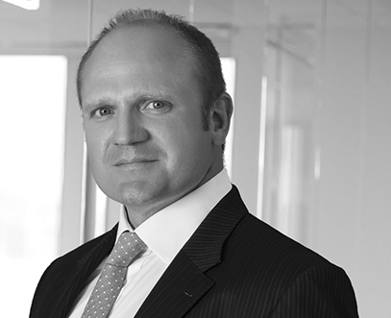
  Getting in touch
  When you need a practical legal solution for your next business opportunity or challenge,
  please get in touch
  Charles Lilley
  Tel: +971 (0)2 652 0302
  +971 (0)50 818 4989
  charles.lilley@bclplaw.com

