Slide 1

Sustainability and the Construction Industry
Richard Bailey
Partner – Druces LLP
Session 5 – 20 October 2023

Slide 2

Introduction
Every day more and more news reaches us of the impact of global warming and the environmental impact humans are having on our planet.
In the world of work and in our personal lives we are bombarded with terminology and demands from government to act more sustainably.
In this talk I will look at these issues and look at how the construction industry is globally trying to rebalance and move to a more sustainable model both through sustainable design and contractual clauses.

Slide 3


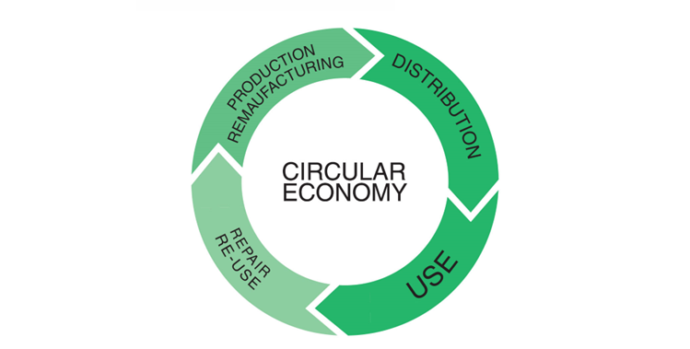

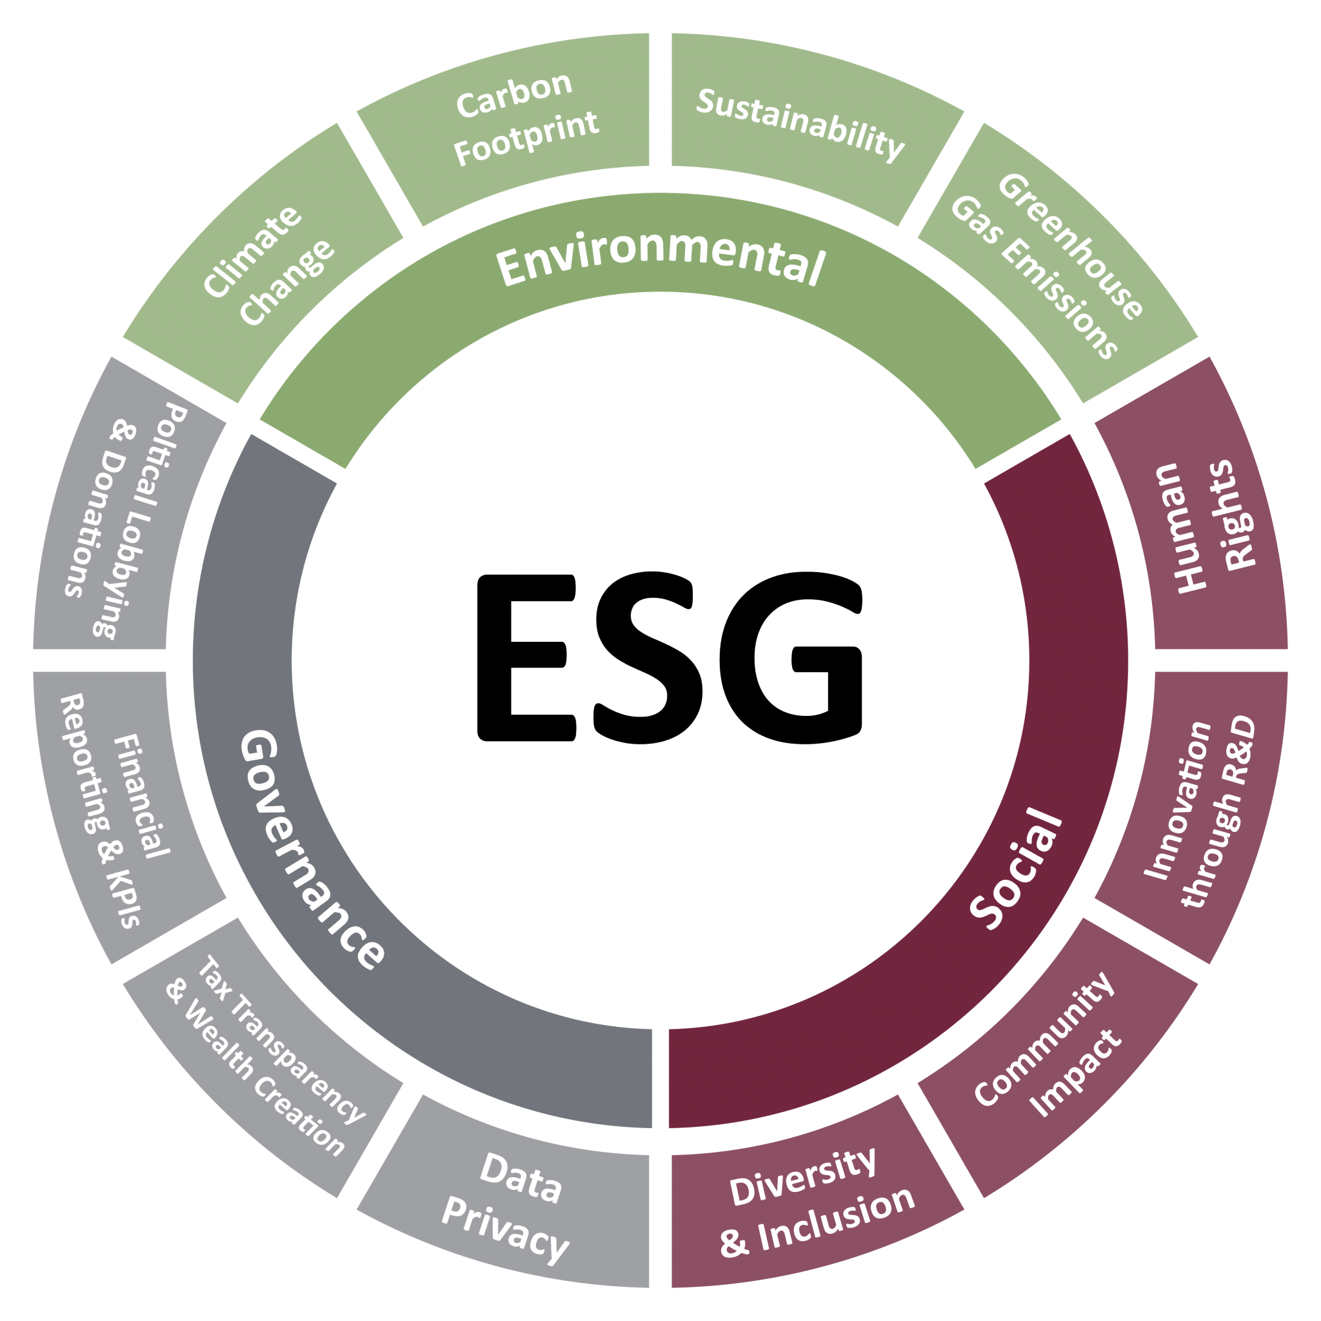
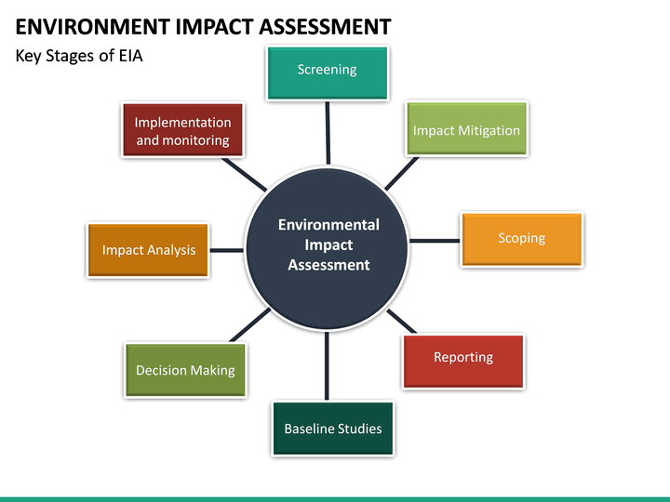

Sustainability

Slide 4
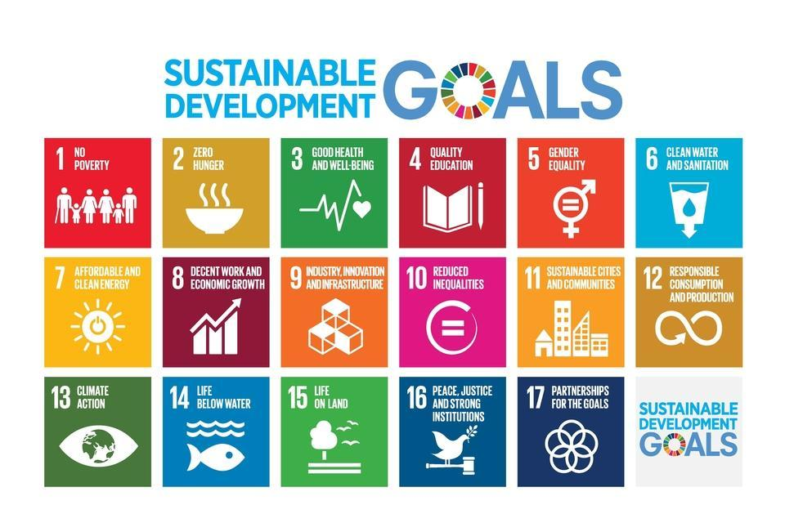
Sustainability

Slide 5

Sustainable Design
Key to the achievement of the objective of sustainability is through the use of sustainable design.
At the forefront of sustainable design are designers using cutting edge design and technology to achieve greater sustainability.
BIM, 3D printing, use of recycled materials all play a part.

Slide 6
Sustainable Design (2)
There are also important pieces of legislation around the world for sustainability including.
Environment Act 2021 (UK)
European Climate Law (EU)
Executive Order Catalyzing America’s Clean Energy Economy Through Federal Sustainability (USA)
Federal Sustainable Development Act 2022 (Canada)

Slide 7
Sustainable Design (3)
One of the leading organisations providing advice and guidance on sustainability is BREEAM from the BRE. While BREEAM started out in the 1990’s it has developed into a system for sustainability in the built environment.
BREEAM has a market share of over 80% for green building certification across Europe, and a fast-expanding reach in Asia and North America.

Slide 8

Sustainable contract provisions
Standard form and bespoke contracts used throughout the world are now playing catch up with the need for sustainable development. Some forms pay lip service to the needs for sustainability making general statements regarding compliance with sustainable objectives.
In the following slides we will look at some examples of clauses drafted as part of the Chancery Lane Project a not for profit organisation www.chancerylaneproject.org

Slide 9
Sustainable contract provisions (2)
The Chancery Lane Project has over 3600 professional participants from 350 participating organisation from 113 countries, it has produced over 160 Model Clauses. Here are some examples.

Slide 10
Sustainable contract provisions (3)
The Chancery Lane Project has over 3600 professional participants from 350 participating organisation from 113 countries, it has produced over 160 Model Clauses. Here are some examples.

Slide 11
Sustainable contract examples
Olivia's Clause - Net Zero Obligations in FIDIC Engineering, Procurement and Construction (EPC) Contracts (UK)
Andrea’s Clause - Green IT/ Green Hardware/ Sustainable Data Centers (Germany)
Willow’s Clause – Construction Materials – Procurement (USA)

Slide 12
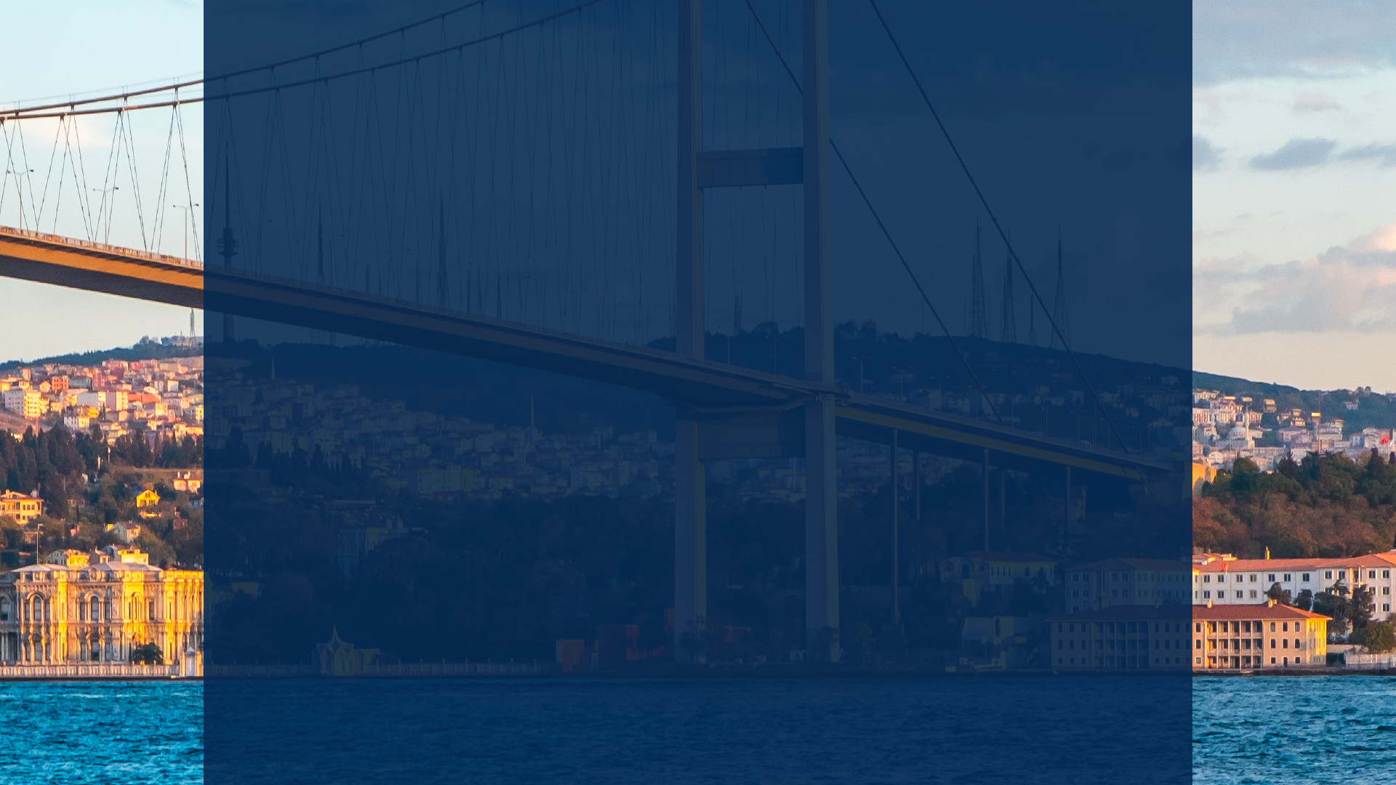
Thank you
Richard Bailey
20 October 2023

