Slide 1

DELIVERING GREEN HYDROGEN PROJECTS
LAINA CHAN, 2 SELBORNE CHAMBERS, MELBOURNE TEC COUNSEL

Slide 2

Green Hydrogen – Allocation of Risks and Dispute Resolution

Slide 3

Production of Hydrogen
Grey Hydrogen – natural gas with steam methane reforming, CO2 byproduct -62% of hydrogen production in 2021 according to the IEA.
Purple or Pink Hydrogen produced from nuclear energy. A 1,000 megawatt nuclear reactor can produce 200,000 tonnes of hydrogen/year – 1/50th of the Hydrogen currently used in the US
Green hydrogen – electrolysis of water using renewable energy sources – solar, wind, hydroelectric – the aspiration

Slide 4
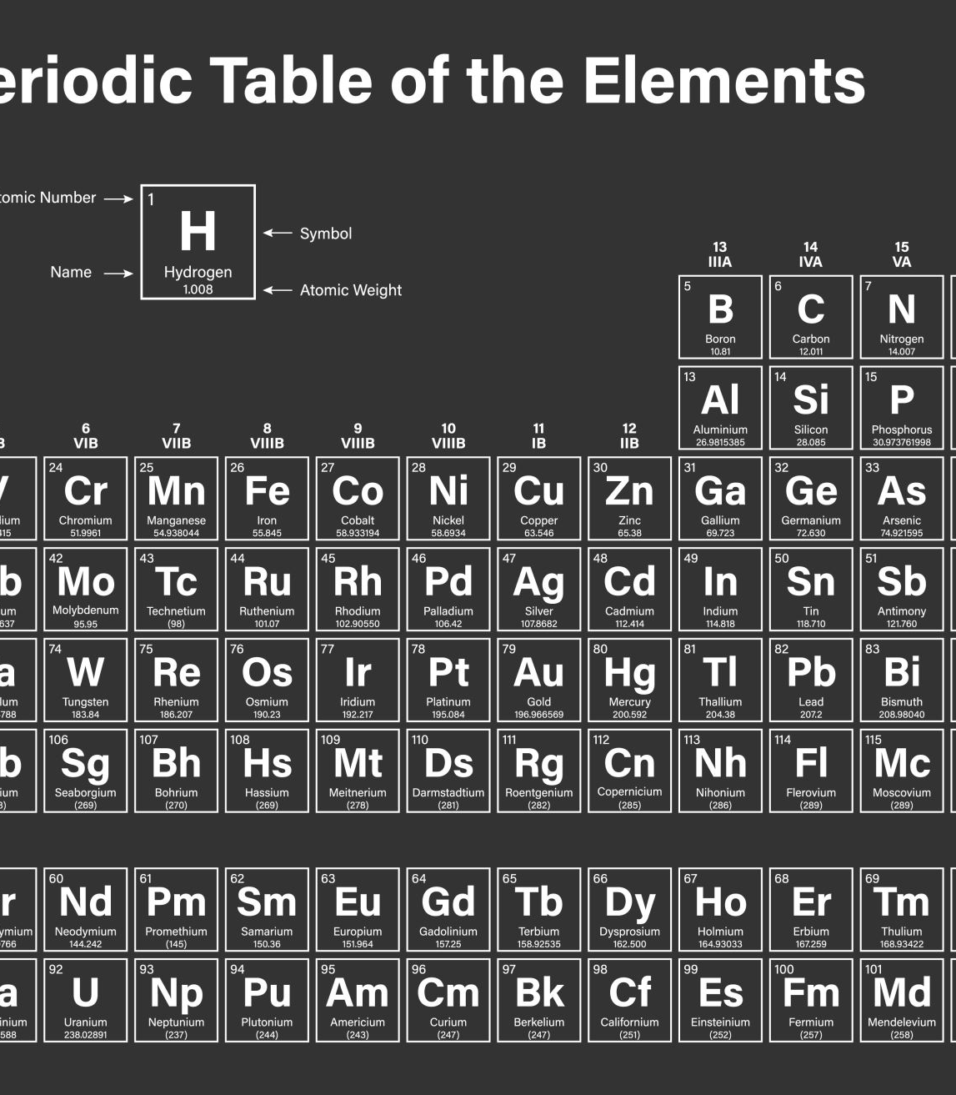
Green Hydrogen
Europe and Australia are front runners in hydrogen production projects using water electrolysis.
Based on the current project pipeline, low-emission hydrogen production from water electrolysers:
in Europe could reach close to 5 Mt H2 by 2030 (projects at advanced and early planning stages),
with Germany and Spain together accounting for 1.4 Mt H2.

Slide 5

Risks in Connection the Production of Green Hydrogen

Slide 6

Issue 1: It’s a construction project!
Offshore wind
Complexity and scale
Harsh, unpredictable environment
Evolving technology
Interface risk
Market context
Contributing factors:
  Pace of change
  Compressed deadlines
  Skills in demand worldwide

Slide 7

Issue 2: Connection, regulation, other stakeholders
Ways to mitigate
Pay attention to risk allocation for delay and ongoing compliance
Good regulatory communication
Early stakeholder engagement
Connection risk and system strength
Ongoing GPS and system strength requirements
Offshore wind is heavily regulated
Community engagement, landowners and other industries

Slide 8

Issue 3:Site Risk
Weather – strong waves, heavy rain, excess wind
Seabed – costly and imprecise
Geology – pumped hydro
Mitigation
Weather – strong waves, heavy rain, excess wind
Seabed – costly and imprecise
Geology – pumped hydro

Slide 9

Issue 4: Evolving Technology
tender designs and specifications becoming redundant
Disputes over rising costs and scope
unexpected defects and performance issues
Ways to mitigate
Consider progressing designs and specifications in stages
Can you select key components later?
Pay attention to drafting of variation mechanism and defects provisions

Slide 10
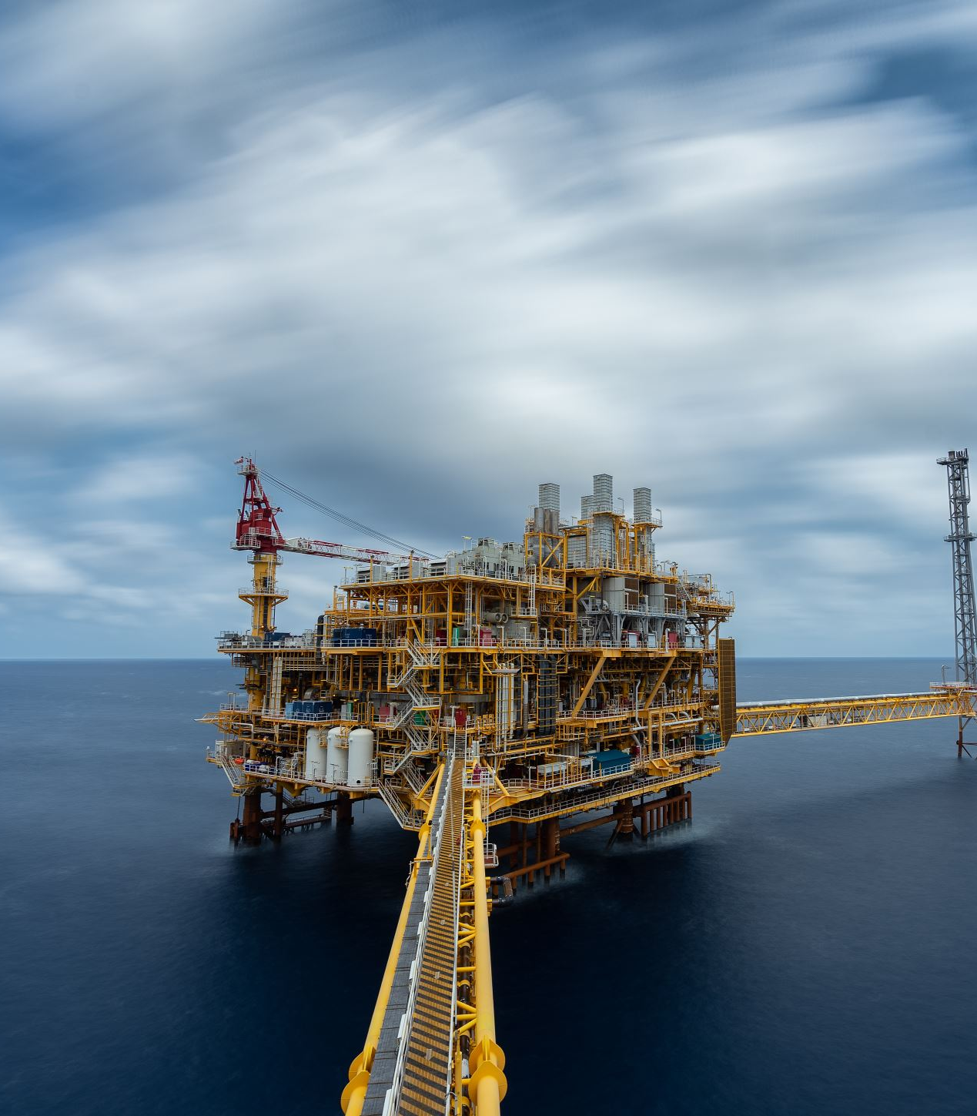
Issue 5: Quality and Supply Chain Issues
Specific supply chain issues in BESS, solar and offshore wind
Offshore wind procurement models
Poor fabrication or damaged components
Electrolysers
Ways to mitigate
Engage early on technical requirements and LD regimes
Consider interface between construction and O&M
Consider scope of warranties and indemnities

Slide 11

Modern Slavery Act 2018 (Cth)
The Modern Slavery Act 2018 (Cth) requires entities with a consolidated revenue >$100M to report annually on the risks of modern slavery in operations and supply chains, and actions to address those risks.
The Commonwealth must report on behalf of corporate and non-corporate Commonwealth entities, and companies with an annual consolidated revenue >$100 million.
Reports are kept by the Minister in the Modern Slavery Statements Register.

Slide 12
China-Australia Free Trade Agreement
Compare America’s Uyghur Forced Labor Prevention Act.
All solar good are banned from China into the US
China-Australia Free Trade Agreement complicates the issue for Australia

Slide 13

Key Legal Issues for Contractors
Compliance with Laws and Regulations
Licensing and Permits
Intellectual Property Rights
Liability and Indemnity
Dispute Resolution Mechanisms

Slide 14

Risk Allocation
Who should bear the risks?
The Owner?
The Contractor?
Both?

Slide 15

Provision of Patent Information
The Principal must undertake due diligence and provide appropriate information to tenderers so they can manage and control those risks.
Mapping of the Seabed.
However, is this enough?

Slide 16

Disputes
Cost overruns and delays
Intellectual property rights
Product liability
Environmental liability
Regulatory compliance

Slide 17

Contractual Disputes
Performance guarantees
MT Hoijgaard AS v E.On Climate & Renewables UK Robin Rigg East Ltd [2018] 2 All ER 22
Wind farm project
Issue with foundational structures
Contractor found to be in breach of 20 year lifetime warranty even though it had exercised due care and skill and complied with J101 (international std for the design of offshore wind turbines)

Slide 18

Nuisance
Uren v Bald Hills Wind farm Pty Ltd [2022] VSC 145
Operator precluded from operating win turbines at night.
Noise was preventing the sheep and the plaintiff from sleeping.

Slide 19

Lal Lal Wind Farm Project
Vestas – Australian Wind Technology Pty Ltd v Lal Lal Wind Farm Nom Co Pty Ltd [2020] VSC 554 (pre-action discovery)
Lal Lal Wind Farms Nom Co Pty Ltd v Vestas – Australian Wind Technology Pty Ltd [2020] VSC 875. (The VSC granted an interlocutory injunction preventing the Contractors from constraining the operation of the wind turbines pending trial.)
Lal Lal Wind Farms Nom Co Pty Ltd v Vestas – Australian Wind Technology Pty Ltd (No 2) [2021] VSC 733 (Attempt to restrain HSF from acting for the plaintiff)
Lal Lal Wind Farms Nom Co Pty Ltd v Vestas – Australian Wind Technology Pty Ltd [2021] VSC 807 (SOPA dispute)

Slide 20

Siemens Gamesa Renewable Energy Pty Ltd v Bulgana Wind Farm Pty Ltd [2020] VSC 126
Project was delayed because of connection issues? The plaintiff sought an injunction restraining the defendant from calling on Performance Securities for payment of Delay Liquidated Damages.
Key terms of Second Agreement:
  1. BWF will continue to offset any DLDs against payments or any amounts due to SGRE for the above project.
  2. Except in any process provided for in clause 41 of the EPC Contract, SGRE undertakes not to object to or oppose any such offset (other than for mathematical mistakes apparent in the DLDs calculations) and additionally will not exercise its rights under or in connection with the security of payment legislation in relation to this matter.
  3. BWF will accordingly not exercise its rights to draw on the Performance Securities in its possession in relation to this matter. For the avoidance of doubt, BWF will not make a demand or claim under the Performance Securities before giving at least 5 business days prior written notice.

Slide 21

Downer Utilities Australia Pty Ltd v Alinta Energy Transmission (Chichester) Pty Ltd [No 2] [2023] WASC 1 – pre-action discovery
The EPC Contract provided for the appointment of a Superintendent, whose functions included determining claims for extensions of time and delay costs, and determining when and whether Practical Completion had been achieved achieved.
The plaintiff alleged that the Superintendent had been improperly influenced by the defendant and had not acted honestly, fairly and reasonably.

Slide 22
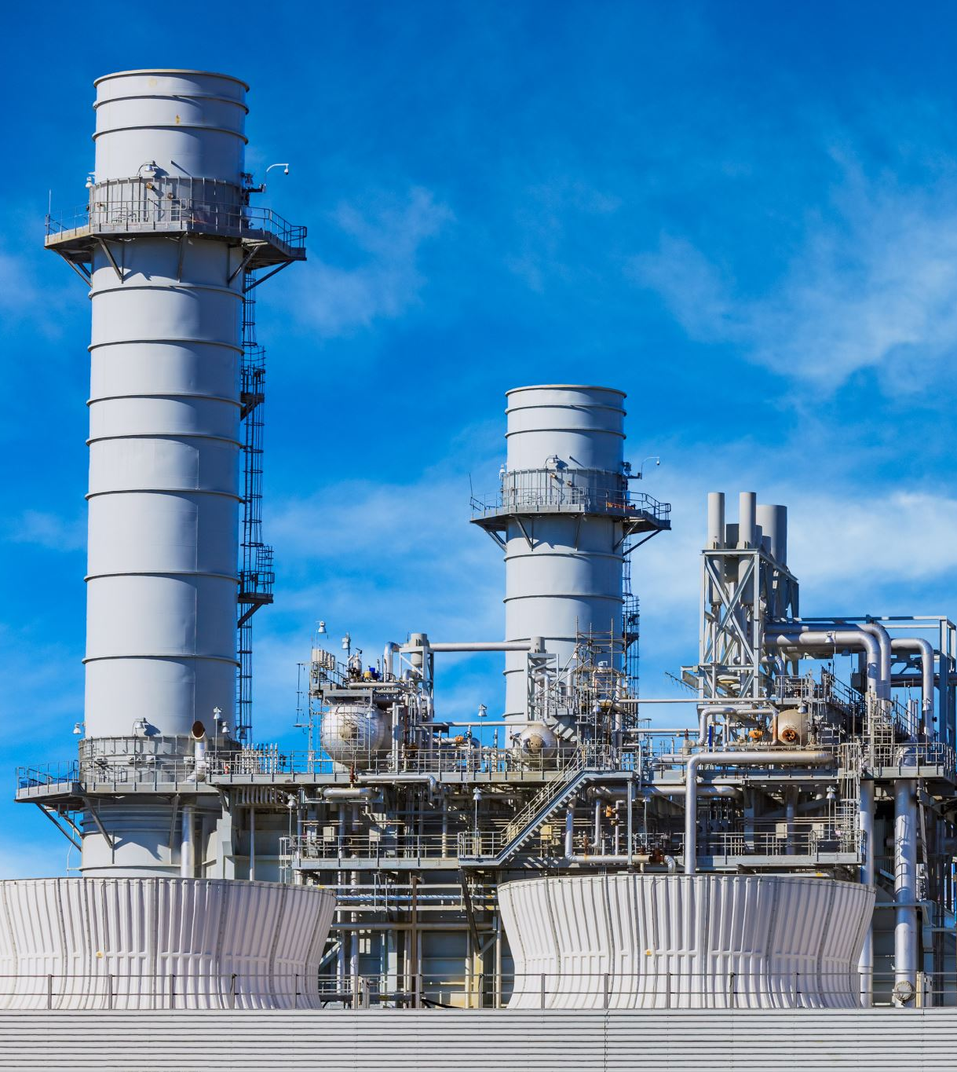
Cape Byron Power I Pty Ltd v Downer Energy Systems Pty Ltd [2022] QSC 294.
EPC Contract to build a boiler for the plaintiff's biomass fired power station.
Boiler was defective and was damaged after overheating.
The plaintiff was awarded the costs of rectification but was precluded from recovering indirect losses.
Indirect Loss was defined as “loss of profits, loss of use, loss of contracts, loss of sales or damages from failure to supply electricity, damages from obligations regarding the receipt of fuel, loss of sales or damages from failure to supply steam, or for any indirect, special or consequential damages arising out of or in connection with this Contract regardless of whether liability is based on any breach of contract, tort (including negligence), indemnity, warranty, statute, or any other basis of liability”

Slide 23

MEDIATION – FACILITATIVE OR EVALUATIVE
Sir Rupert Jackson procedure for Evaluative Mediation:
  Position Papers on liability and quantum;
  40 min presentation by each counsel during mediation;
  Mediation delivers an oral indication of who is likely to win on each issue and why
  Lunch break to allow parties to consider options/offers
  Conventional facilitative mediation to address quantum with no views expressed on Quantum by Mediator

Slide 24


A presentation for SCL International 20 October 2023
LAINA CHAN, 2 SELBORNE CHAMBERS, MELBOURNE TEC COUNSEL
E: laina.chan@selbornechambers.com.au

