Slide 1
Daily Windows Analysis Revisited
Daily windows analysis has been around for more than 20 years, but until recently it has been prohibitively resource intensive and time consuming.
However, recent advances in computer software technology along with new insights in schedule updating, has made this form of delay analysis highly precise and the calculations extremely fast.
This presentation will focus on these insights and advances to demonstrate how they have dramatically changed both the time and cost it takes to perform a daily windows analysis.

Slide 2
Problem 1: Classic Approach to Windows Analysis
Typically, Windows or Time-Slice Delay analysis is performed by updating in-progress activities based on the amount of remaining work estimated by the planner. This seems to follow common sense as intuitively one would think that this value is the most accurate and, therefore, the proper way to estimate remaining durations of activities. Moreover, it is the way that planners typically update schedules. The formula for obtaining these values would be the following:
D(r) = D(o) * (1-PC)
Where:
D(r) = Remaining Duration
D(o) = Original Duration
PC = Estimated Decimal Percent Complete of the Work (Todd Dunn, 2005).
However, because, work progresses in a non-linear manner, and can even go backwards if progress is lost during the prosecution of the work. This would seem to necessitates the planner to estimate the remaining work for every day, in order to obtain accurate results, which can be prohibitively time consuming

Slide 3
Understanding Cause versus Effect of a Delay Event
However, a closer inspection of this method of updating reveals that it can produce flawed results as it can quantify a delay before one has actually occurred.
The confusion is found in the cause versus effect of updating by remaining work rather than remaining time. Updating by remaining work can more accurately reveal the cause of a delay, but can miscalculate the effect or quantification of a delay. Whereas, updating based on remaining time, better quantifies the impact of the delay, but does not shed light on the cause of a delay. Both are important in understanding and quantifying impact.
The following example demonstrates the difference:

Slide 4
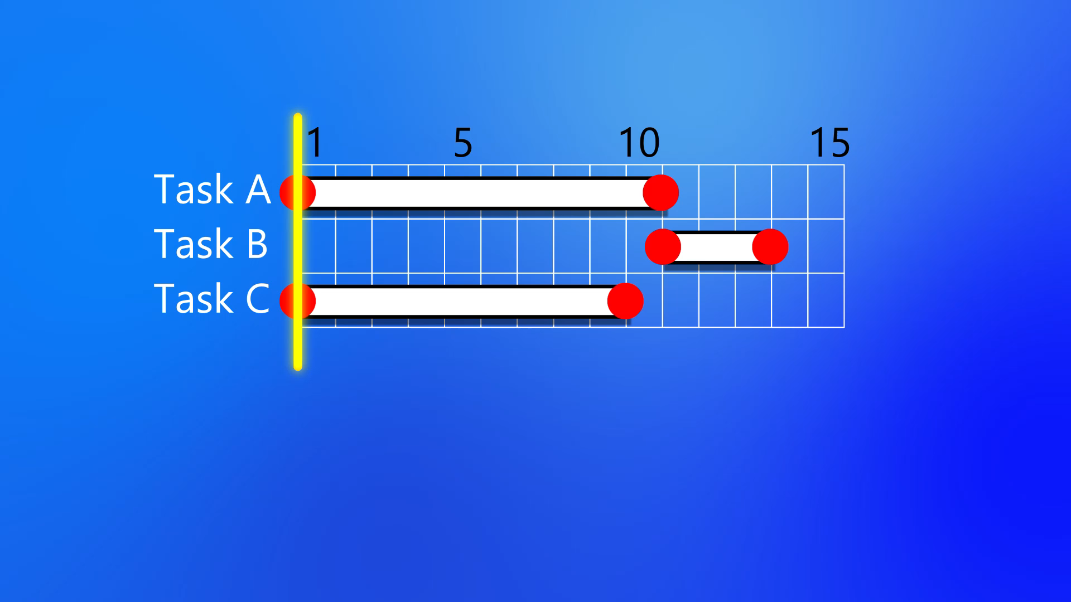
How Updating Using Remaining Work Can Provide Misleading Delay Quantifications

Slide 5
Updating In-progress Activities Based on Remaining Time
The quantification of delay becomes objective
It is uniformly applied across the network
And the calculation of progress becomes linear:
              D(r) = D(o) – D(a)
              Where:
              D(r) = Remaining Duration
              D(o) = Original Duration
              D(a) = Actual Duration
Using this updating method no longer requires the user to estimate remaining work for every day of an activity’s progress toward completion. This dramatically lessens the amount of work and resources needed to complete the analysis, while improving the accuracy of quantifying impacts.

Slide 6
Problem 2: Computational Effort to Calculate Sizable Schedules with Hundreds of Delay Events Over Years of Daily Progress.
Until recently, even with linear equations to perform daily calculations, the time it takes to execute these calculations was prohibitive, and the ability to put the data together to recognize trends and continuity limited.
However, with the advent of recent progress in software and hardware capabilities, these barriers have been completely removed. Specifically the following progresses have played key roles in this development:
                Artificial Intelligence
                Parallel Programming
                Tethering
                SHA-256 Algorithm

Slide 7
Advances in Software Techniques
  Artificial Intelligence – Neural networks use feedback from massive amounts of data to develop deep learning capabilities. These combined with the precision of a daily windows analysis can recognize trends in the data and respond to questions posed to it in plain English.
  Parallel Programming – A software technique which maximizes access to different processing sections in a computer, so that independent tasks are being simultaneously executed. Since each day in a daily windows analysis is calculated separately, this means many days of analysis can be calculated at the same time, depending on the amount of cores on your computer.
  Tethering – A connection between two applications which allow calculations to be performed on a different computer than the main application. This allows a separate work station on the network to do the heaving lifting calculations without slowing down the computer being used by the primary user of the software.
  SHA-256 - An algorithm which creates a 256 bit one way encryption, transforming data into a unique fixed length character string, called a hash. There is currently no way to decipher the encryption in a direct manner, as the number of possible outcomes exceeds by orders of magnitude, the number of particles of sand, on all the beaches and oceans over the entire earth. This makes it a very useful tool to compare data in schedules and identify exactly where a planner has made changes to the values in a Primavera XER file. This in turn quickly allows applications to isolate changes and calculate their impact.

