Slide 1

AI-Generated Arbitral Decisions: A Not-So-Futuristic Discussion in the Light of a Recent Belgian Supreme
Court Ruling
Cagdas Evren Bayrak, ProADR
LLM, BScEng, DipAdj, FCIArb, FICCP, MCIOB, CPCM, PMP, CCME
& FIDIC President’s List Adjudicator

Slide 2


The Use of Artificial Intelligence in Legal Practice
Artificial Intelligence, sometimes referred to as the “Fourth Industrial Revolution”, is likely to fundamentally reshape the Legal Profession. Many believe that the AI will take over most of the work which humans do
in the Legal business now, in a not-so-distant future.
The Use of AI in the Legal Practice in general can be broadly classified into
two categories:
1- AI as a “LegalTech” Tool
2- AI-Enabled Judicial Decision-Making

Slide 3
“LegalTech Tool” / Practical Uses of the AI
Enhanced Legal Research: AI-driven algorithms deliver comprehensive and efficient analysis of Case Laws, Precedents, Statutes, Regulations etc.
E-Discovery: Scanning electronic information to obtain non-privileged information relevant to a case using search terms or specific parameters.
Transcription, Interpretation & Translation: AI Speech Recognition technology identifies speakers and generates real-time transcripts with speaker identification. AI platforms also excel at instant document interpretation and translation, seamlessly handling scanned, handwritten, or annotated materials.
Document Management & Automation: AI-driven software effectively stores, organizes, and simplifies retrieval of legal files (contracts, case files, emails, notes etc.), while also enabling effortless document creation using intelligent templates.
Selection of Arbitrators, Experts & Counsels: AI can be used for selection and appointment of experts, counsels, and arbitrators according to specified criteria.

Slide 4
“LegalTech Tool” / Practical Uses of the AI
Generative AI (ChatGPT, Bard etc.)
Use of Generative AI grows exponentially, but legal professionals should
exercise caution.
Mata v. Avianca (2023)
Mr. Mata injured his knee when a metal cart on his Avianca flight struck him. In bringing his lawsuit, Mata chose to instruct Mr. Steven Schwartz, a New York
based lawyer with 30 years of experience who presented the court with a 10-page document in support of the claim proceeding which cited numerous cases
including Martinez v Delta Airlines, Zicherman v Korean Air Lines, and Varghese v China Southern Airlines, which seemingly supported his argument wonderfully.
The problem? None of these cases actually existed! The document was drafted by ChatGPT instead which produced completely falsified case examples.

Slide 5

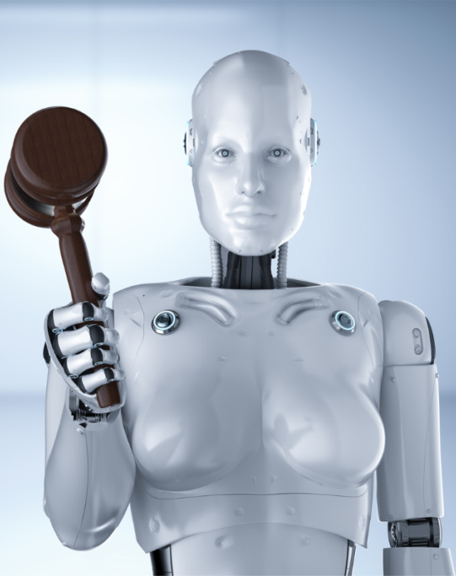
AI-Enabled Judicial Decision-Making
Current Uses of AI in Judicial Decision-Making:
1- Administrative & Civil Cases: AI is widely used on relatively small Administrative
and Civil Cases (e.g. including subdistrict/local/small claims court cases),
family-law cases or employment matters etc. where the outcome is largely or
entirely certain based on the data supplied.
Courts in Michigan, Ohio, California, Wisconsin and Utah implemented
algorithm-based ODR, primarily for small claims, traffic violations, outstanding
warrant cases, and low-conflict family court cases.
(Conversely, among others, DoNotPay.com claims to be a "robot lawyer" service
that uses AI to provide various legal services.)
British Columbia’s Civil Resolution Tribunal (CRT) is an ODR for resolving
strata and other disputes including small claims up to $5,000
China’s Internet Courts feature AI judges that take evidence, ask questions,
set schedules, and issue rulings.
Israel, India and various other countries are working on AI based decision-
support systems in civil cases

Slide 6
AI-Enabled Judicial Decision-Making
UK’s HMCTS Reform Programme: The MoJ is implementing a reform program
that includes the use of AI to make administrative decisions in courts, such as
scheduling cases and managing paperwork.
Estonia is developing an AI judge that can adjudicate small claims disputes
of less than EUR 7,000.
2- Criminal Cases:
United States: Correctional Offender Management Profiling for Alternative
Sanctions (COMPAS) system has been used by the judges as one factor in their
decisions to assess the risk of recidivism for individuals awaiting sentencing.
Public Safety Assessment (PSA) is an actuarial assessment that estimates
failure to appear in court pretrial, new criminal arrest while on pretrial release, and
new violent criminal arrest while on pretrial release.
Australia: In some states, AI systems are used to help magistrates make
bail decisions. These systems assess the risk of individuals not appearing in court
or reoffending and provide recommendations.

Slide 7
AI-Enabled Judicial Decision-Making
Singapore is exploring the use of AI in sentencing decisions e.g. analyse the
severity of the offense and defendant's history for sentencing recommendations.
Some Canadian provinces experimented with AI systems to provide judges
with sentencing recommendations.
However such uses of AI draw a lot of criticism as well in respect of due process,
transparency, bias, public policy, relying on precedence rather than facts etc.
Loomis v. Wisconsin
In February 2013, Eric Loomis was sentenced to 6 years in prison by a judge in
Wisconsin, who looked at his criminal record as well as “high-risk of re-offending”
score assigned by COMPAS software. Loomis appealed on the grounds of
violation of the Due Process, in that COMPAS algorithms’ inner workings could
not be fully examined, and insofar as it could, COMPAS violates Due Process
rights by also taking gender, race and socio-economical background into account.

Slide 8



AI in International Arbitration
“Robo - Arbitrators”: Are they around the corner?
Everyone is aware what AI can do to “replace Humans” – but apart from certain technical challenges that exist today (which may be resolved by better coding and computational power - except perhaps for “lack of emotional intelligence”), what
essentially lacks is no legislation expressly addresses this possibility. It is not
dealt with in the existing legislation simply because, “robo-arbitrators” were not envisaged at the time of their drafting, and this raises a problem with the
composition of the arbitral tribunal: in some legislations, the arbitrators are defined
(or implied) as persons, so by definition they cannot be robots.
New York Convention (1958): Article I (2) - The use of arbitrators in this article is
not exclusively addressed to human arbitrators
Article V 1(a) - This first provision refers to the arbitration agreement holding that
a decision might be refused by the losing party if it “is not valid under the law to
which the parties have subjected it or, failing any indication thereon, under the
Law of the country where the award was made”
Use of AI in Arbitration & AI-Enabled Arbitral Decisions: Very much alike with the Courts
Robo-Arbitrators: Sci-Fi or Just a Matter of Time?
Inevitable Current Uses of the AI in Judicial Decision – Making:
AI is used on relatively small administrative & civil cases (including subdistrict/
local/small claims court cases), family-law cases or employment contracts etc.
where the outcome is largely or entirely certain based on the data supplied.
Courts in Michigan, Ohio, California, Wisconsin and Utah implemented
algorithm-based ODR, primarily for small claims, traffic violations, outstanding
warrant cases, and low-conflict family court cases.
(Conversely, among others, DoNotPay.com claims to be a "robot lawyer" service
that uses AI to contest parking tickets and provide various other legal services.)
British Columbia’s Civil Resolution Tribunal (CRT) is an ODR incorporated
into the public justice system for resolving strata and other types of disputes
including small claims disputes up to $5,000
China’s Internet Courts feature AI judges that take evidence, ask questions,
set schedules, and issue rulings.
Civil Resolution Tribunal (CRT) British Columbia -

Slide 9
AI in International Arbitration
UNCITRAL Rules (2006): Article 11 - In relation to the appointment, “that no
person shall be precluded by reason of his nationality from acting as an arbitrator”
Article 12 (1) - In relation to challenging an arbitrator, that “when a person is
approached in connection with his possible appointment as an arbitrator, he shall
disclose any circumstances (…)”
Arbitration Agreement: Being the ‘foundation stone of the arbitration” the parties
can technically decide to have their commercial issues resolved through AI
instead of a human arbitrator thus the Parties can produce their private system
of justice. However, the Arbitration Agreement to comply with other elements
of the arbitration legal framework and be enforced:
France, Netherlands, Belgium, Portugal etc.: Only Natural Persons or
Individuals can be Arbitrators.
China, Indonesia, Vietnam, Egypt, Finland, Iceland etc.: Require certain
attributes that only a human arbitrator may have (years of experience etc.)

Slide 10
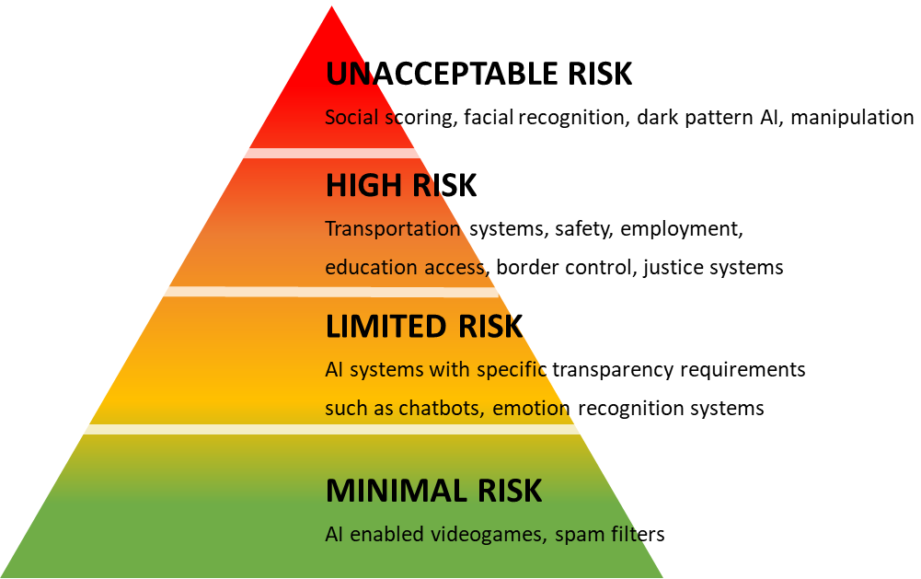
AI in International Arbitration
EU AI Regulation: First thorough AI regulation adopts a “risk-based” approach:
Prohibited
Conformity Assessments
Transparency
Code of Conducts
Law enforcement that may interfere with people’s fundamental rights (e.g.
evaluation of the reliability of evidence) and administration of justice and
democratic processes (e.g. applying the law to a concrete set of facts) are
considered High-Risk

Slide 11
Secretaries in International Arbitration
Secretaries / Assistants are quite common in International Arbitration. They are usually junior lawyers in the Chair’s Firm or PhD students etc, and are very instrumental by assisting the tribunal on administrative matters (therefore help reducing the arbitration costs significantly)
But to what extent can the Secretaries be influential on the tribunal’s decisions? Moreover, can they draft the Arbitral Awards?
Emek İnşaat and WTE Group v European Commission (2023)
The underlying dispute arose over the construction of sewage systems, a water pipeline and pumping stations under a EUR 10.6 Million FIDIC contract in Cyprus. After defects were discovered in the system, the Commission accused the contractors of improper performance of works, while the contractors, in turn, accused the Commission of errors in designing the system.
The ICC arbitral tribunal, with the parties' consent, relied on an arbitral secretary's assistance. Following a partial defeat, the losing party asked each arbitrator to clarify the secretary's role in the preparation of the arbitral award (similar to the Yukos case: the Fourth Arbitrator).

Slide 12
Secretaries in International Arbitration
The Chair confirmed that the arbitral secretary had prepared the draft list of questions that he had then reviewed, and confirmed that the secretary had attended but not participated in the discussions between the arbitrators. The chair stated that he had been assisted in the drafting of the award but “there was not a single sentence and not a single footnote in the award that he had not reviewed, verified or corrected so as to align it with the result of the tribunal's deliberations”. The co-arbitrators added that all arbitrators had a thorough knowledge of the case file and that all arbitrators had worked collectively and intensely on the draft award.
The Chair of the tribunal then resigned having considered that he was not used to working in an atmosphere of accusations and mistrust and that he was
not impartial anymore.
Subsequently, the losing party applied to the Brussels Court of First Instance to
set aside the award. It argued that there was an irregularity in the arbitral procedure due to the illegitimate delegation of the arbitral decision-making powers to the arbitral secretary and that the arbitral tribunal's president was impartial.

Slide 13
Secretaries in International Arbitration
One of the paramount principles of arbitration is that arbitrators are selected on a personal basis (intuitu personae) hence they may not delegate their decision-making powers.
In Belgium, if an arbitrator does delegate their powers, the award they render may be set aside under article 1717 3 (a) (v) of the Belgian Judicial Code (which is based on article 34(2)(a)(iv) of the UNCITRAL Model Law) or exequatur of the award may be refused on the ground of article V(1)(d) of the New York Convention.
The Brussels court held that, as a matter of principle, arbitral secretaries are allowed to draft portions of awards or entire arbitral awards on the condition that arbitrators do not delegate their decision-making powers (which are not delegated by mere reliance on a secretary's drafting the award). In the view of the court, a secretary’s work is not limited to purely administrative tasks. It also encompasses intellectual contributions, which could potentially impact the decision-making process of the tribunal

Slide 14
Secretaries in International Arbitration
The court went on to analyze para. 187 of the ICC’s Note, which states that “a request by an arbitral tribunal to an administrative secretary to prepare written notes or memoranda shall in no circumstances release the arbitral tribunal from
its duty personally to review the file and/or to draft any decision of the arbitral tribunal”. In the court’s opinion, para. 187 implicitly authorizes a tribunal to rely on its secretary to draft parts of an arbitral award or even the entire award, as long as the tribunal reviews and corrects the draft according to its own views. If the ICC would have wanted to exclude this possibility, the court ruled, it would not have used the words “and/or” in para. 187.
This was escalated by the losing party to the Belgian Supreme Court, which upheld the Brussels Court’s judgment (24 April 2023). There were basically two legal questions to be answered:
1- The court confirmed that Belgian Judicial Code’s relevant articles on delegation of arbitrator’s powers are not applicable for arbitration
2- Conformed that the interpretation of the First Instance Court's of ICC Note paragraph 187 is not irreconcilable

Slide 15


“Robo - Secretaries” in International Arbitration
Article 220 of the ICC Notes (on Appointment of the Tribunal Secretary):
“There is no formal process for the appointment of an administrative secretary. However, before any steps are taken to appoint an administrative secretary, the arbitral tribunal must inform the parties of its intention to do so.
For this purpose, the arbitral tribunal must submit to the parties the proposed administrative secretary’s curriculum vitae, together with a declaration of independence and impartiality, an undertaking on the part of the administrative secretary to act in accordance with the present Note and an undertaking on the part of the arbitral tribunal to ensure that this obligation on the part of the administrative secretary are met.”

Slide 16
“Robo - Secretaries” in International Arbitration
“Robo-Secretaries” that not only assist in the arbitration process but draft the award as well (partially or in full) seems viable and enforceable (plus very handy from a cost-perspective as well), provided that;
The Parties agree at the outset that an AI will be the tribunal secretary of which data handling and decision-making principles are set out transparently
The decision drafted by the AI secretary / assistant be vetted by the Arbitral Tribunal
If institutional arbitration, then the Rules shall be suitable:
  ICC, SIAC, LCIA, SCC and JAMS – Secretary gets appointed by mutual agreement of all parties
  HKIAC & ICCA – Tribunal appoints the Secretary then the parties may raise objections thereto
  E.g. CEPANI rules specifically bar the Secretaries to be involved in deliberations of the arbitral tribunal or be entrusted with drafting the
  arbitral award

Slide 17
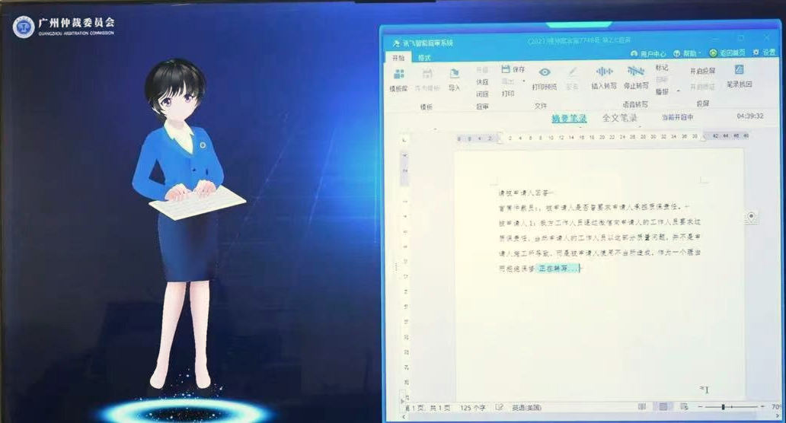
“Robo - Secretaries” in International Arbitration
Quite recently, an AI assistant developed by Guangzhou Arbitration Commission was showcased during the Guangdong-Hong Kong-Macao Greater Bay Area Legal Forum proved competent in not only supporting the Tribunal for completing the procedural tasks, but it provided them with its judgement as well.

Slide 18
THANK YOU!
Cagdas Evren Bayrak, ProADR
LLM, BScEng, DipAdj, FCIArb, FICCP, MCIOB, CPCM, PMP, CCME
& FIDIC President’s List Adjudicator

